Slide 1
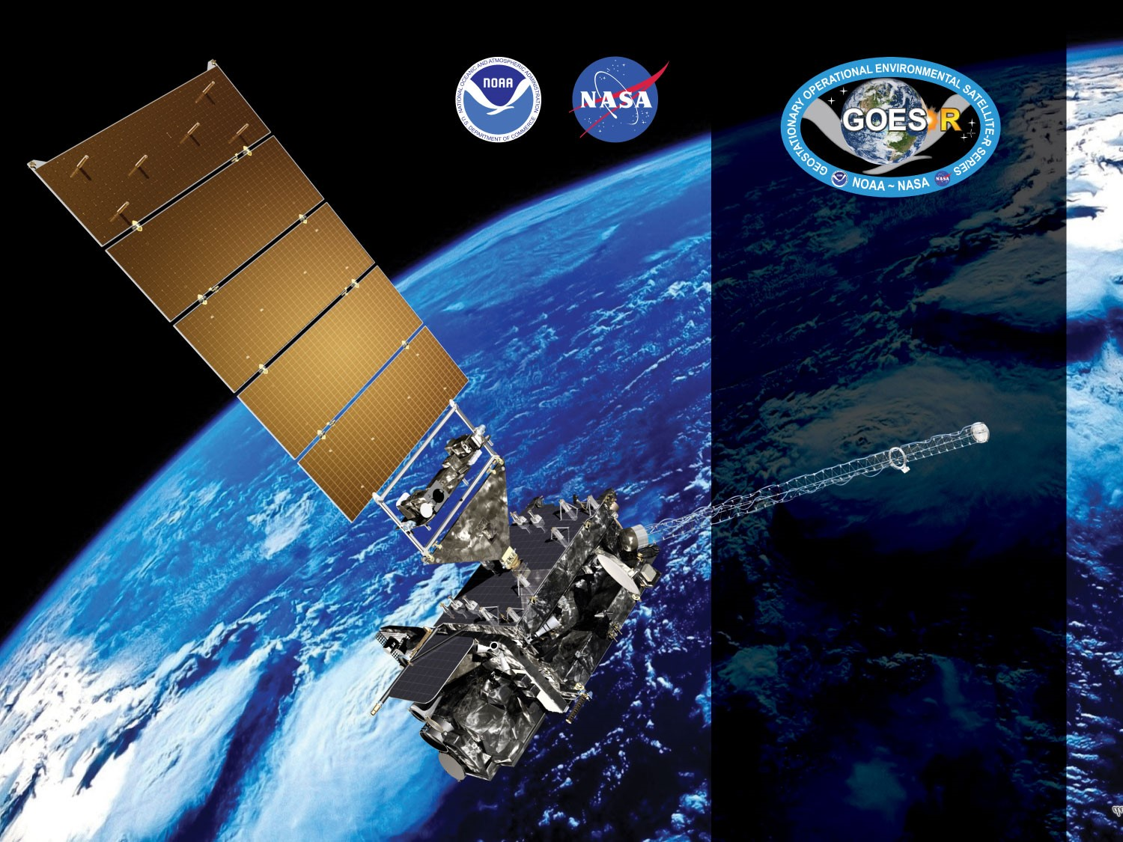
GOES-18 ABI L2+
Ice Concentration
Ice Age/Thickness
Provisional PS-PVR
December 29, 2022
GOES-R AWG
Xuanji Wang¹
Feng He²
Hong Zhang¹
Jeff Key³
Yinghui Liu³
¹CIMSS/UW-Madison
²CCR/UW-Madison
³NOAA/NESDIS/STAR
Notes:
PS-PVR - Peer-Stakeholder Product Validation Review

Slide 2
Outline
For each product - Ice Concentration and Ice Age/Thickness:
Product Overview
Product Quality Evaluation
Product Validation
Provisional Maturity Assessment
Overall summary and recommendations

Slide 3
GOES-18 ABI L2+
Provisional PS-PVR
Ice Concentration
Presenter: Feng He
CCR/UW-Madison
December 29, 2022
GOES-R AWG
Notes:
PS-PVR - Peer-Stakeholder Product Validation Review

Slide 4
PRODUCT OVERVIEW
GOES-18 ABI Ice Concentration Provisional PS-PVR

Slide 5
Ice Concentration Background
Sea and lake ice concentration reports the fraction (in percentage) of the sea or lake surface covered by ice. Total concentration includes all stages of development that are present.
GOES-18 ice concentration Environmental Data Record (EDR) consists of two products: Full Disk (FD) and CONUS.
User needs:
National Ice Center request for use in generating ice charts
Alaska Ice Program’s request to monitor ice conditions
General users for long-term global sea and lake monitoring, commercial transport, inputs for numerical weather forecasting.

Slide 6
Mission Requirements
Products | Sea and Lake Ice Concentration: CONUS | Sea and Lake Ice Concentration: Full Disk
Geographic Coverage | CONUS | Full Disk
Horizontal Resolution | 3 km | 10 km
Mapping Accuracy | ≤ 1.5 km | ≤ 5 km
Measurement Range¹ | 0/10 – 10/10 | 0/10 – 10/10
Measurement Accuracy (%) | 10.0 | 10.0
Measurement Precision (%) | 30 | 30.0
Refresh Rate | 180 minutes | 6 hr
Mission Product Data latency | 60 minutes | 180 minutes
Temporal Coverage Qualifier² | Solar Zenith Angle < 67 | Solar Zenith Angle < 67
Product Extent Qualifier³ | Local Zenith Angle < 67 | Local Zenith Angle < 67
Cloud Cover Conditions Qualifier | Clear | Clear
¹ The product generates ice concentration in percentage, 0-100%. ² The product generates ice concentration in both daytime and nighttime. ³ The product is Quantitative out to at least 67 degrees LZA and qualitative at larger LZA.

Slide 7
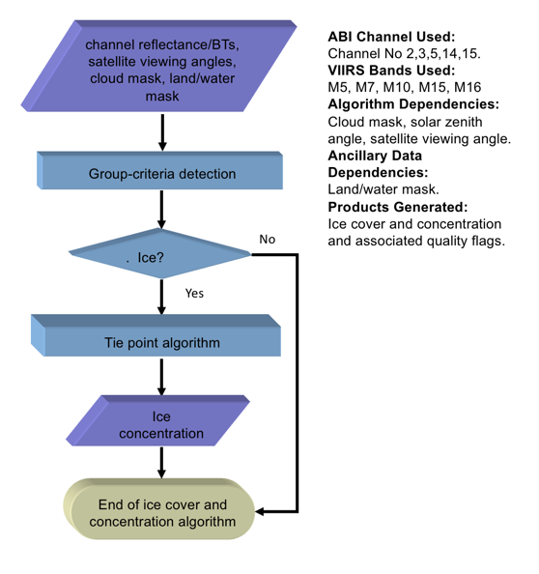
Ice concentration flow chart
High level flowchart of the ice cover and concentration algorithm illustrate the main processing sections.

Slide 8
Algorithm Overview
Read in the sensor data, ancillary data (land/sea mask), and derived product (cloud mask);
Calculate the ice surface temperature using split-window approach
T_{s} = a + bT₁₁ + c(T₁₁ − T₁₂)+ d [(T₁₁ − T₁₂)(secθ − 1)] T_{s} is the estimated surface skin temperature (K),
T₁₁ and T₁₂ are the brightness temperatures (K) at 11 μm and 12 μm bands,
θ is the local zenith angle, and a, b, c, and d are retrieval coefficients.
Apply threshold tests to detect ice covered pixels based on NDSI (Normalized Difference Snow Index), reflectance at 0.86 𝝁m, and surface temperature in daytime and surface temperature at nighttime;
Derive the ice concentration using a tie point algorithm.
C_{p} = (B_{p} − B_{water})/(B_{ice} − B_{water})
where B_{water} is the reflectance or temperature of pure water pixels,
B_{ice} is the reflectance or temperature of pure ice pixels (tie point reflectance or temperature),
and B_{p} is the observed reflectance or temperature of the pixel.

Slide 9
Product quality evaluation
GOES-18 ABI Ice Concentration Provisional PS-PVR

Slide 10
Top Level Summary of Product Quality
The sea and lake ice concentration product quality is satisfactory
Overall performance is compared to products from other sensors
The sea and lake ice concentration product is ready for operational use and for use in comprehensive cal/val activities and product optimization.

Slide 11
GOES-16 and GOES-18 Data Used in this Review
GOES-16/18 GS/PDA Data
Goes-18 Full Disk data every 3 hours, Nov 15-Dec 20, 2022
Goes-16 Full Disk data every 3 hours, Nov 15-Dec 20, 2022
Goes-16/18 Full Disk daily composites, December 1-25, 2022
Performance, accuracy and precision, was examined.

Slide 12
PRODUCT VALIDATION
GOES-18 ABI Ice Concentration Provisional PS-PVR

Slide 13
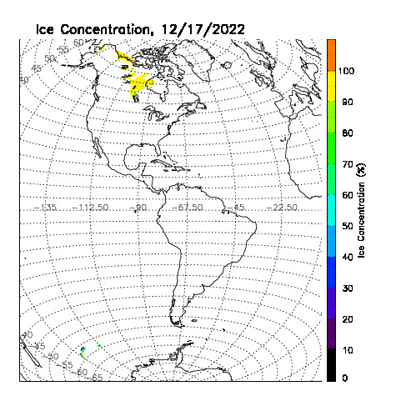
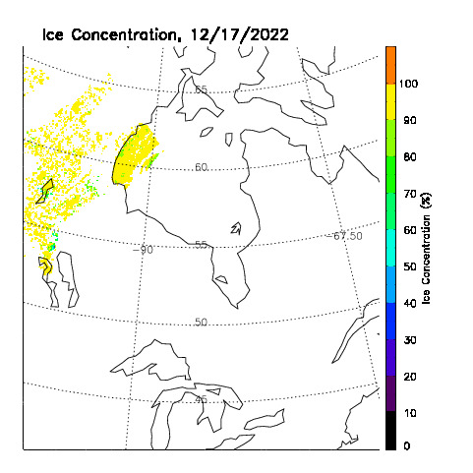
Qualitative/Visual Inspection
GOES-18, 2022-12-17, Ice Concentration
GOES-18, 2022-12-17, Ice Concentration
GOES-18 daily composite ice concentration data from the GS/PDA.

Slide 14
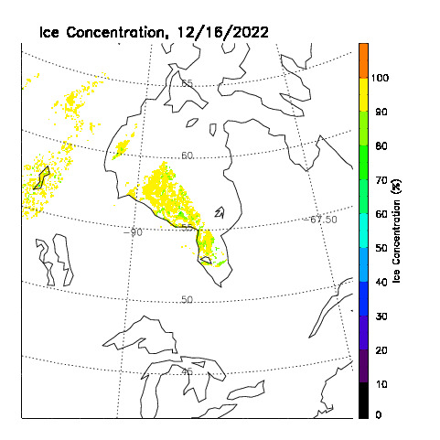
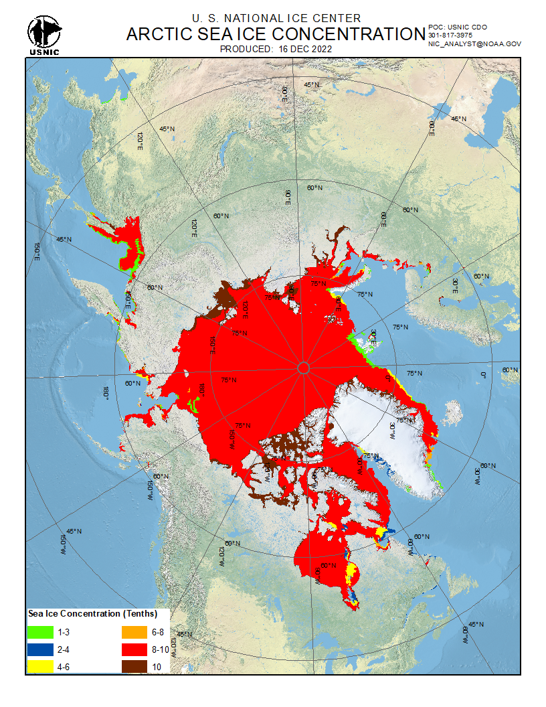
Qualitative/Visual Inspection
GOES-18, 2022-12-16, Ice concentration
US NIC, 2022-12-16, Ice concentration

Slide 15
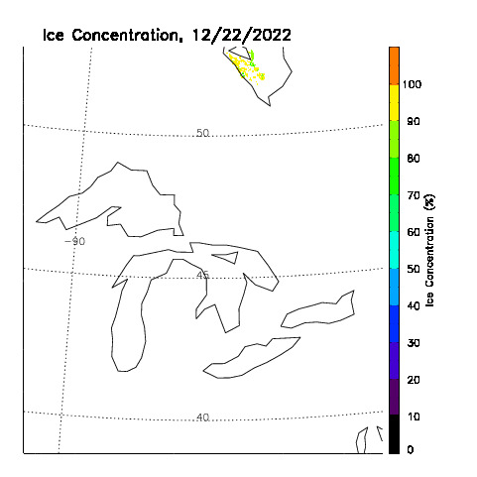
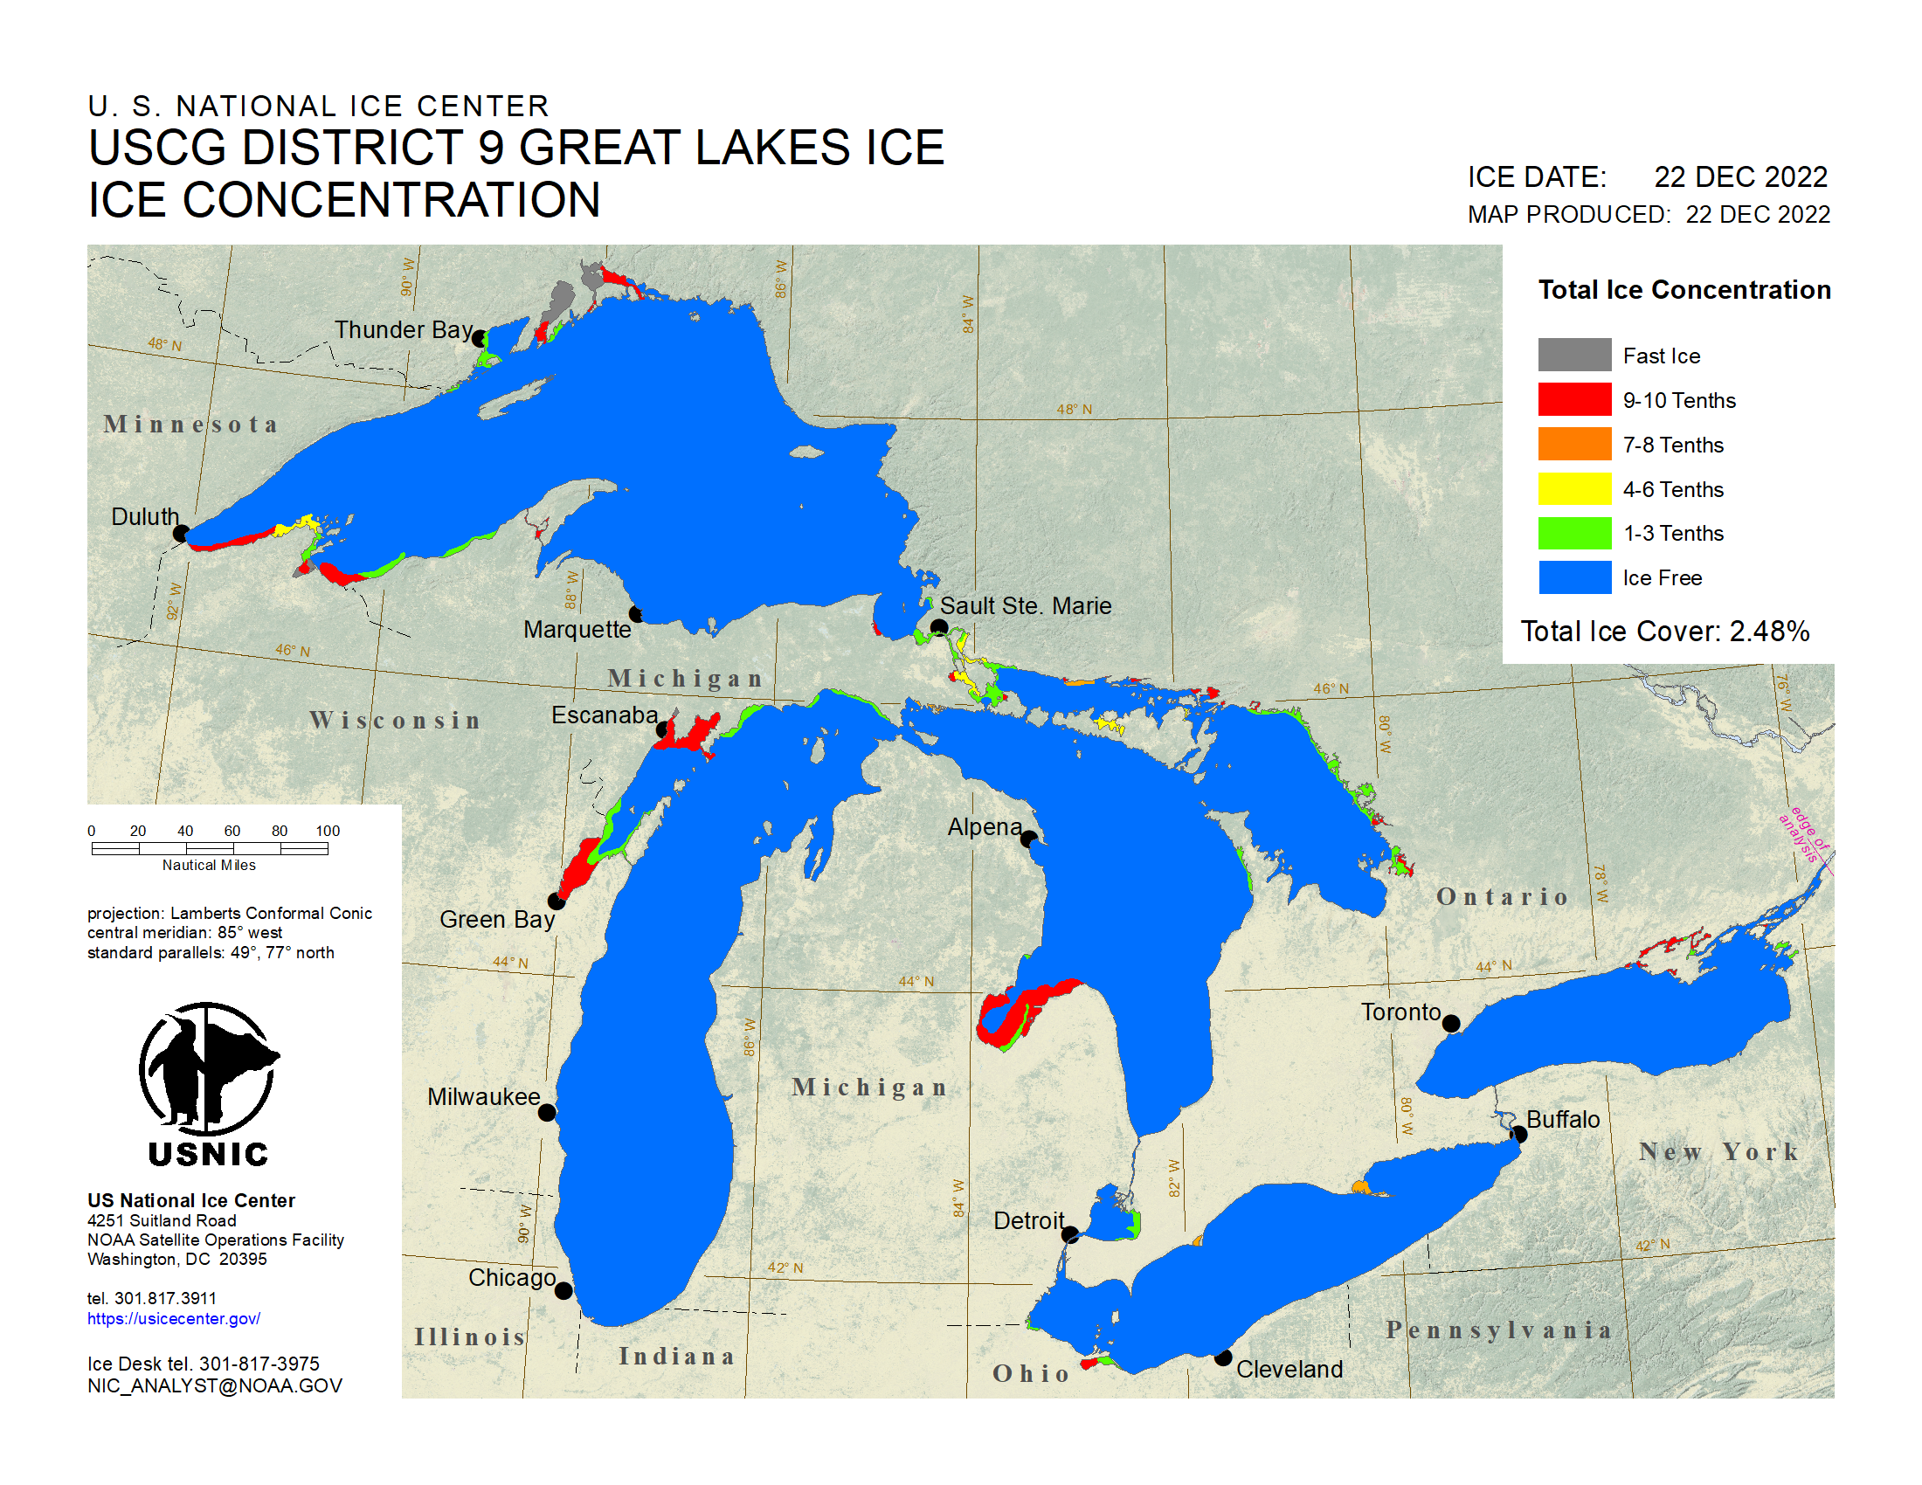
Qualitative/Visual Inspection
GOES-18, 2022-12-22, Ice concentration
US NIC, 2021-12-22, Ice concentration
No ice retrieved with GOES-18 data due to cloudy sky over ice area.

Slide 16
Reference Data
Reference data sets:
The AMSR2 (Advanced Microwave Scanning Radiometer 2 ) instrument onboard the GCOM-W1 (Global Change Observation Mission 1st – Water) satellite is a twelve-channel, six-frequency, passive-microwave radiometer system. The AMSR2 NOAA enterprise sea ice product includes sea ice concentration using NASA team 2 algorithm mapped to an Equal-Area Scalable Earth Grid (EASE-Grid) version 2 at 2-km spatial resolution. The reference data sets covers daily AMSR2 ice concentration from November 15 to December 18, 2022.
The VIIRS (Visible Infrared Imaging Radiometer Suite) instrument is a whiskbroom scanner radiometer that collects imagery and radiometric measurements of the land, atmosphere, cryosphere, and oceans in the visible and infrared bands of the electromagnetic spectrum. The reference data sets include daily VIIRS ice concentration from November 15 to December 19, 2022.

Slide 17
Calibration/Validation Results

Slide 18
Validation Procedures
Matchups (set of quasi-coincident and collocated GOES-16/GOES-18 and reference data):
Passive microwave ice concentration from AMSR2 (Advanced Microwave Scanning Radiometer 2), which has been validated and is an operational NOAA product.
GOES-18 ice concentration and ice mask, and AMSR2 ice concentration are remapped to 2 km EASE-Grid 2.0 (Equal-Area Scalable Earth version 2).
Hourly GOES-18 data are compared to daily AMSR2 data.

Slide 19
PLPTs three stages validation
There are currently no Full Validation PLPTs for ice products. The table below lists the types of tests to be performed.
TEST ID | Short Description
ABI-FD_Ice01 (Beta) | Verify each product is generated at the required cadence for FD
ABI-FD_Ice02 (Provisional) | Perform qualitative inspection of each FD product
ABI-FD_Ice03 (Full) | Assess the accuracy and precision of each FD product

Slide 20
Provisional Maturity Assessment
GOES-18 ABI Ice Concentration Provisional PS-PVR

Slide 21
Provisional Validation
Preparation Activities | Assessment
Validation activities are ongoing and the general research community is now encouraged to participate. | True
Severe algorithm anomalies are identified and under analysis. Solutions to anomalies are in development and testing. | There are no severe, or even mild, algorithm anomalies.
Incremental product improvements may still be occurring. | The results of this review are not dependent upon any planned improvements.

Slide 22
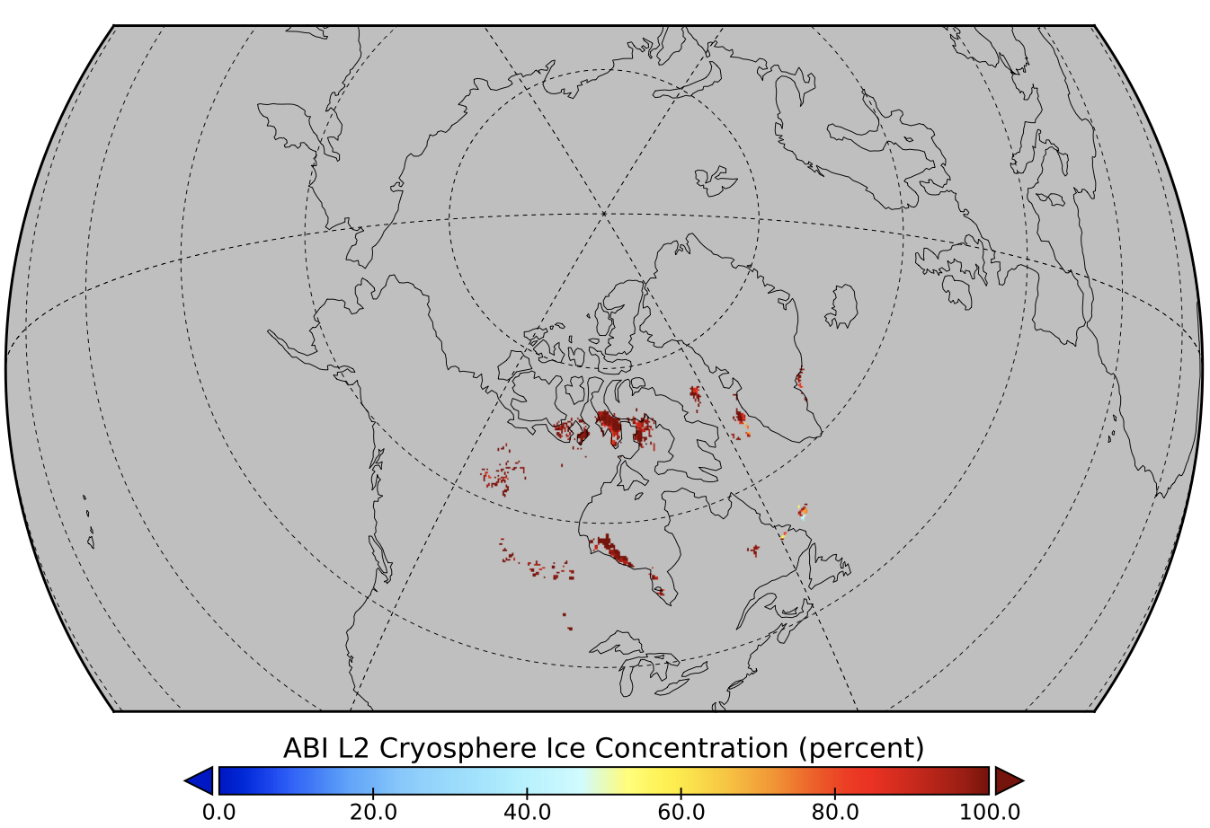
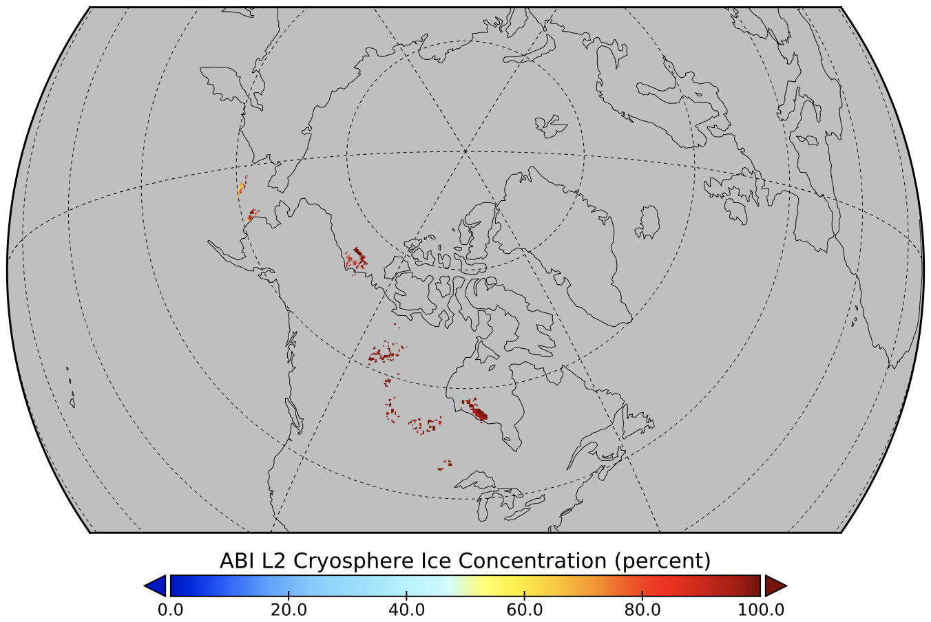
Sea and Lake Ice Concentration Validation Case Study: GOES-16 vs GOES-18 ABI
GOES-16, 2022-12-20, 12 UTC
GOES-18, 2022-12-20, 12 UTC
Ice Concentration

Slide 23
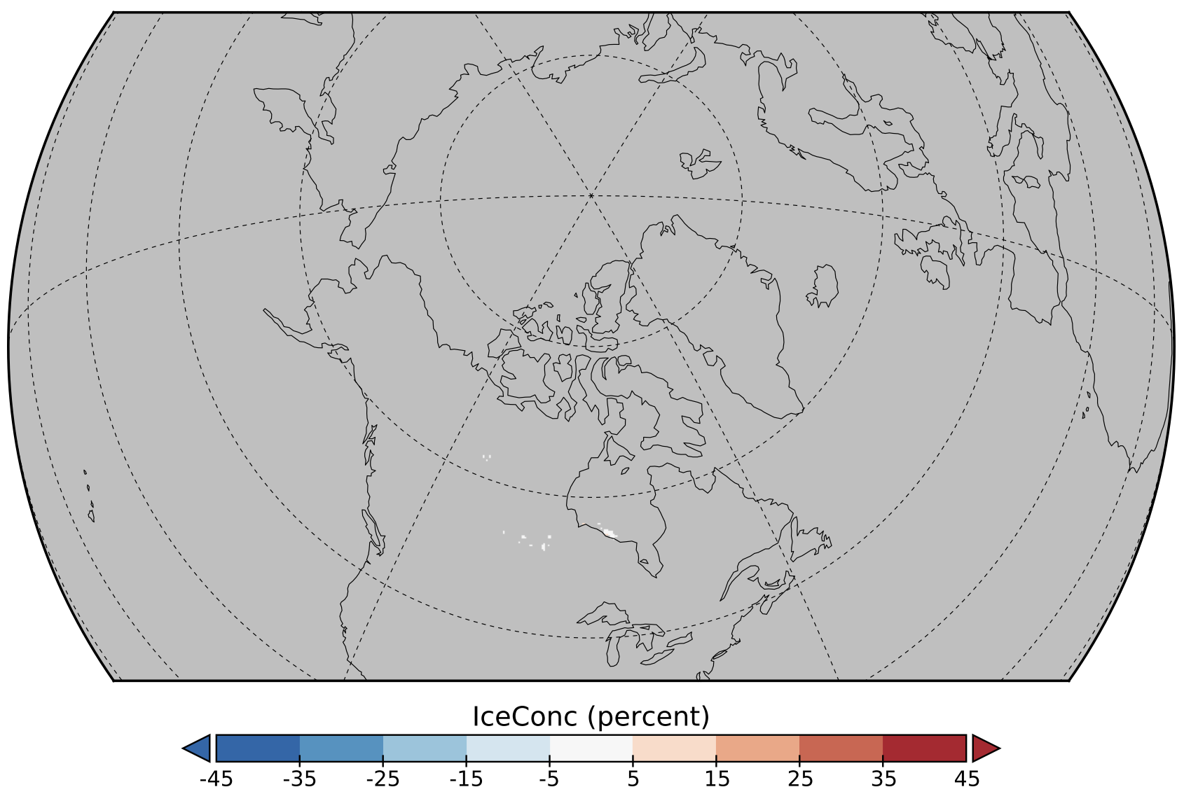
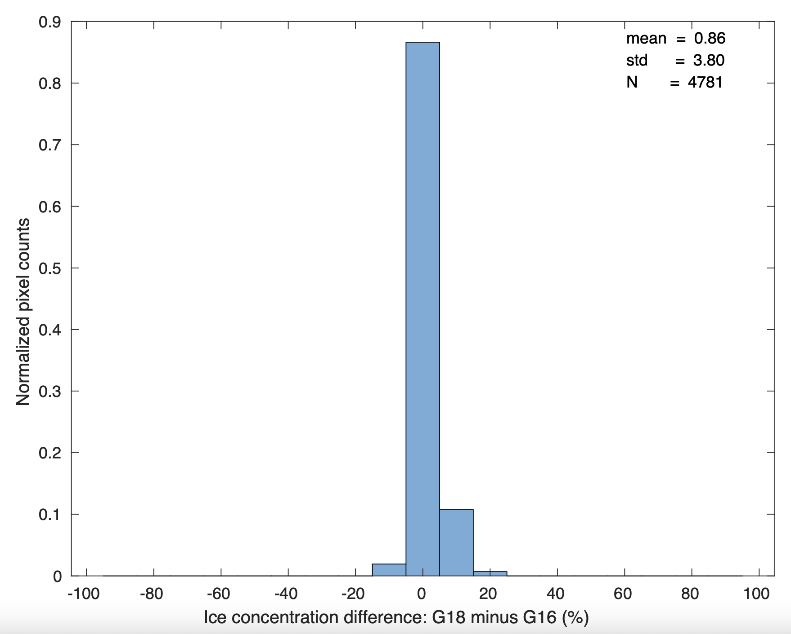
Sea and Lake Ice Concentration Validation Case Study: GOES-16 vs GOES-18 ABI
GOES-18 minus GOES-16, 2022-12-20, 12 UTC
accuracy:
Ice Concentration
precision:
Accuracy: 0.86%
Precision: 3.80%

Slide 24
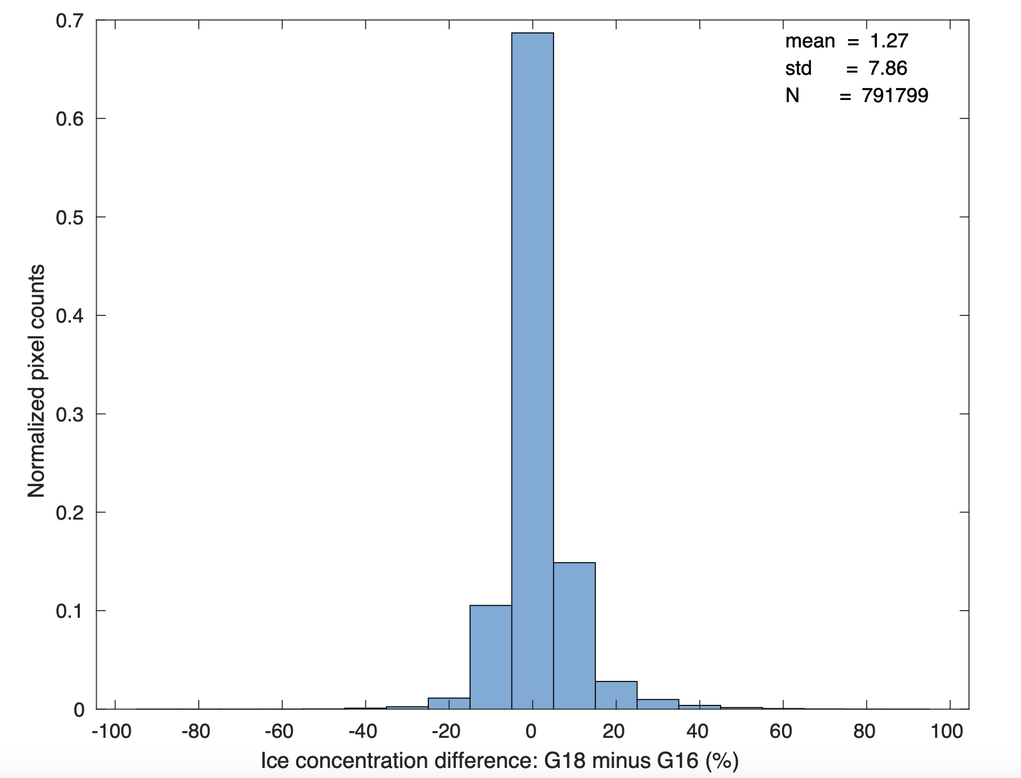
Sea and Lake Ice Concentration Validation Overall Performance: GOES-16 vs GOES-18
GOES-18 minus GOES-16,
All co-located data, Nov 15 - Dec 20, 2022
Accuracy: 1.27%
Precision: 7.86%
accuracy:
precision:

Slide 25
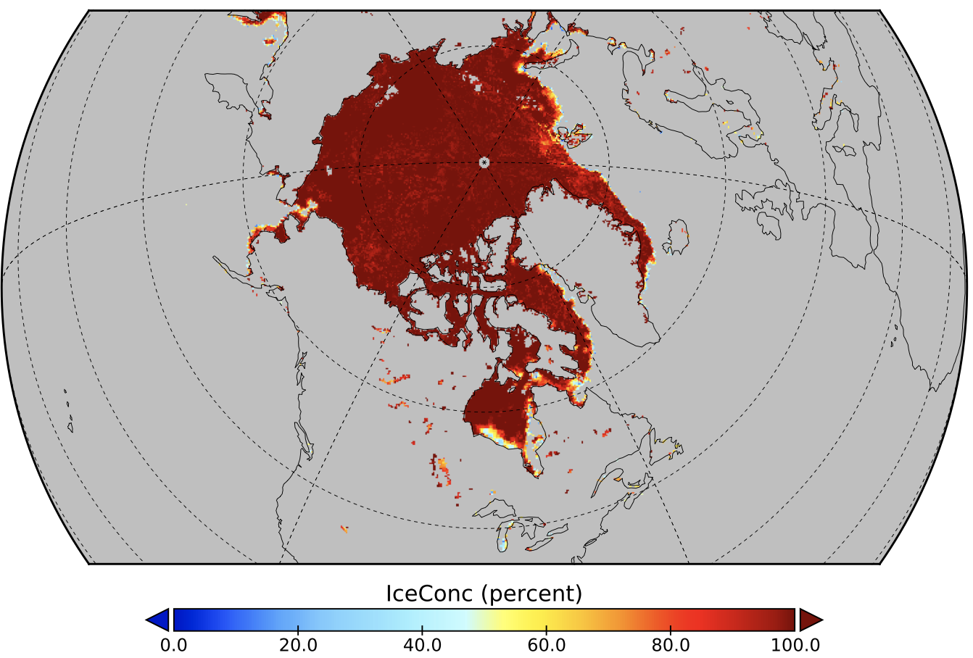
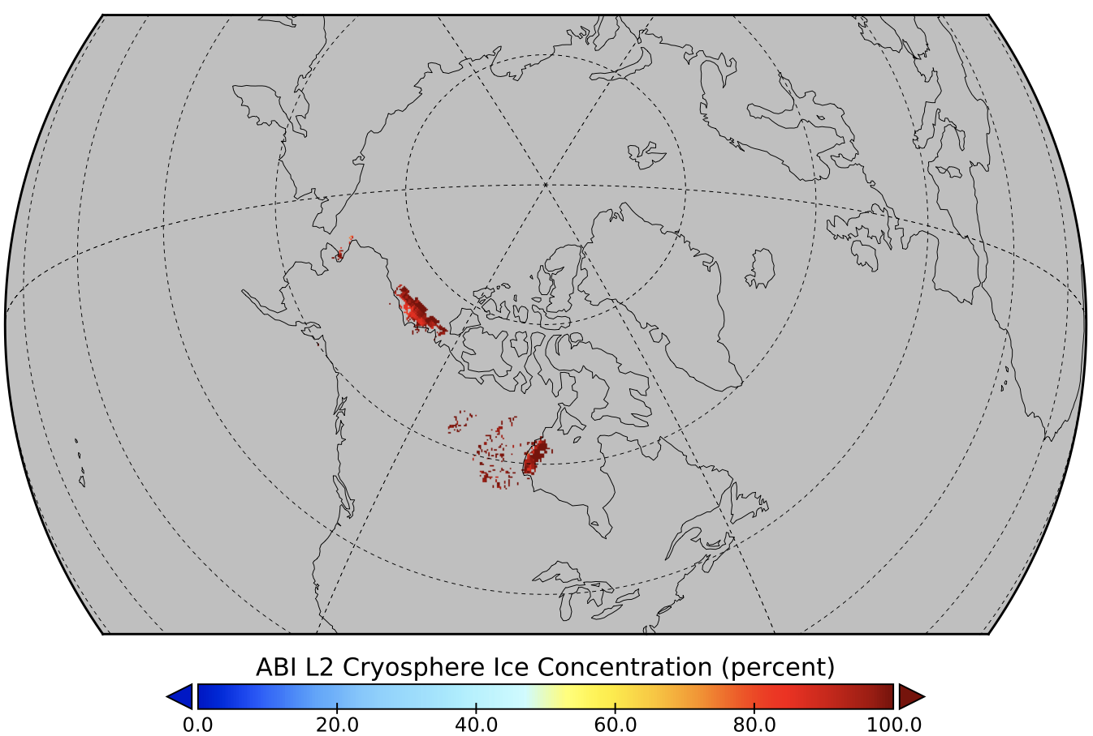
Sea and Lake Ice Concentration Validation Case Study: AMSR2 vs GOES-18 ABI
AMSR2, 2022-12-17
GOES-18, 2022-12-17, 21 UTC
Ice Concentration

Slide 26
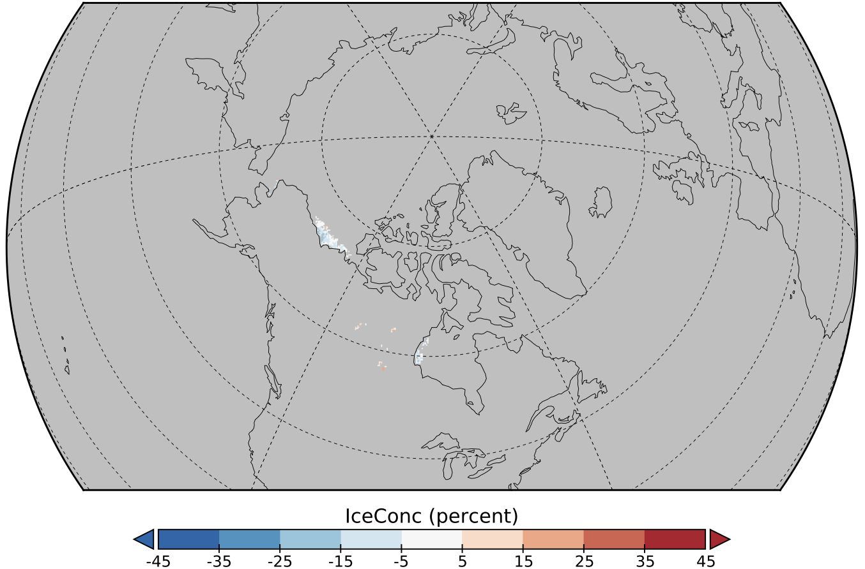
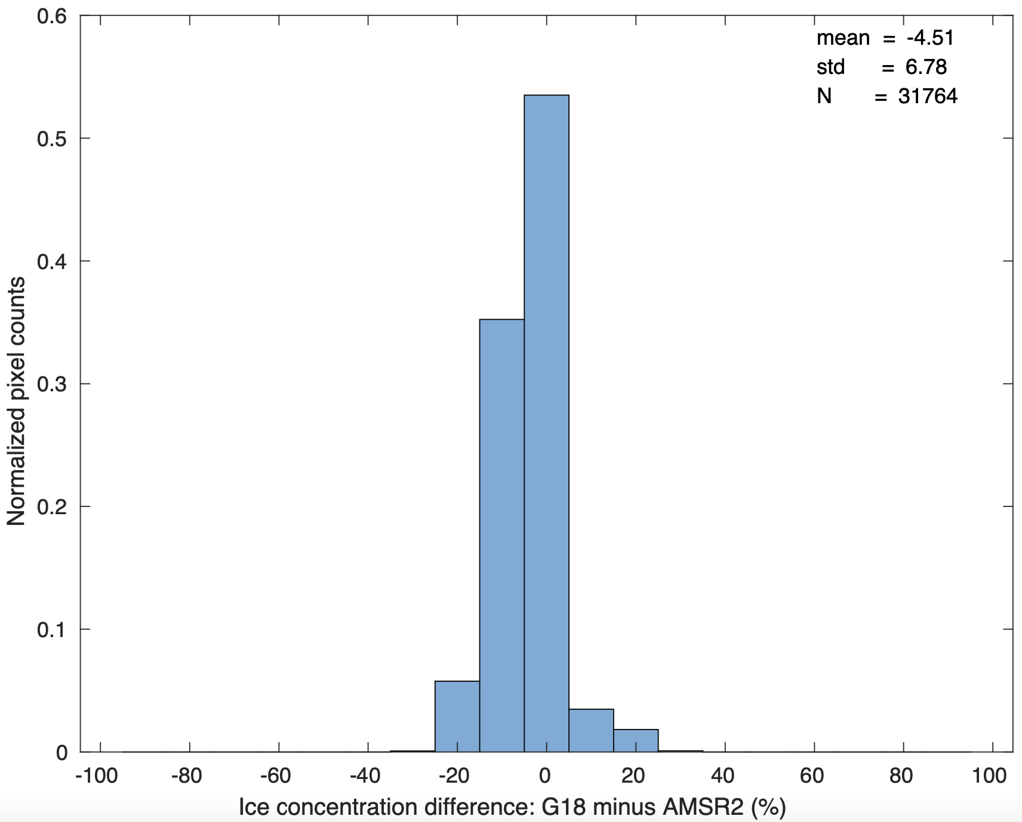
Sea and Lake Ice Concentration Validation Case Study: AMSR2 vs GOES-18 ABI
GOES-18 minus AMSR2, 2022-12-17, 12 UTC
Ice Concentration
accuracy:
precision:
Accuracy: 4.51%
Precision: 6.78%

Slide 27
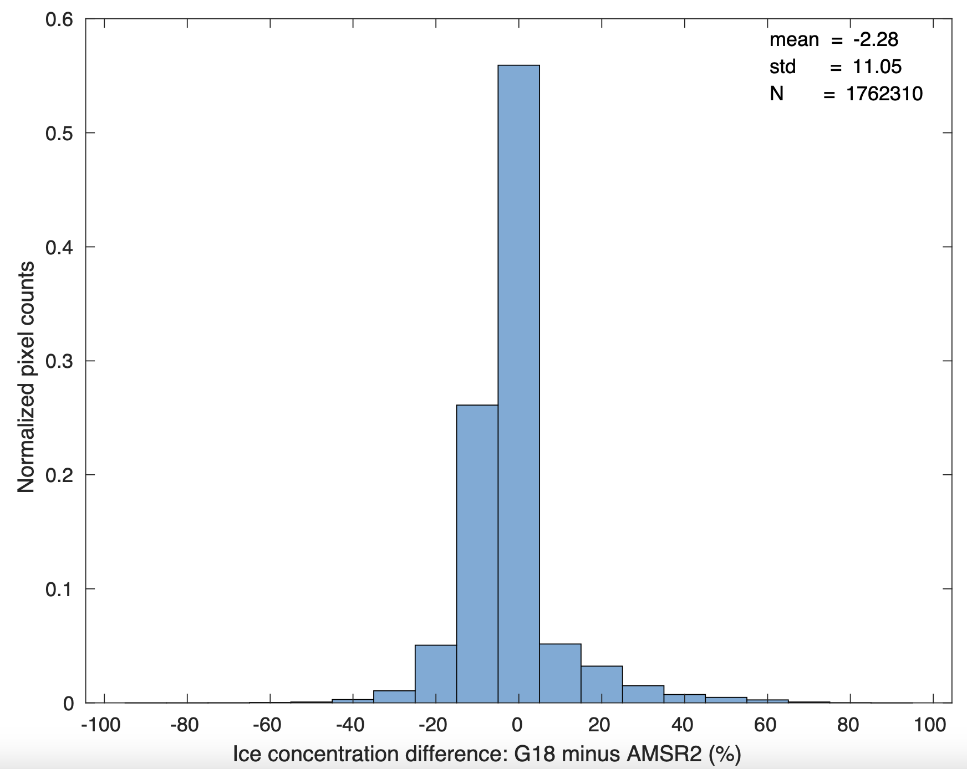
Sea and Lake Ice Concentration Validation Overall Performance: AMSR2 vs GOES-18
GOES-18 minus AMSR2,
All co-located data, Nov 15 - Dec 18, 2022
Accuracy: 2.28%
Precision: 11.05%
accuracy:
precision:

Slide 28
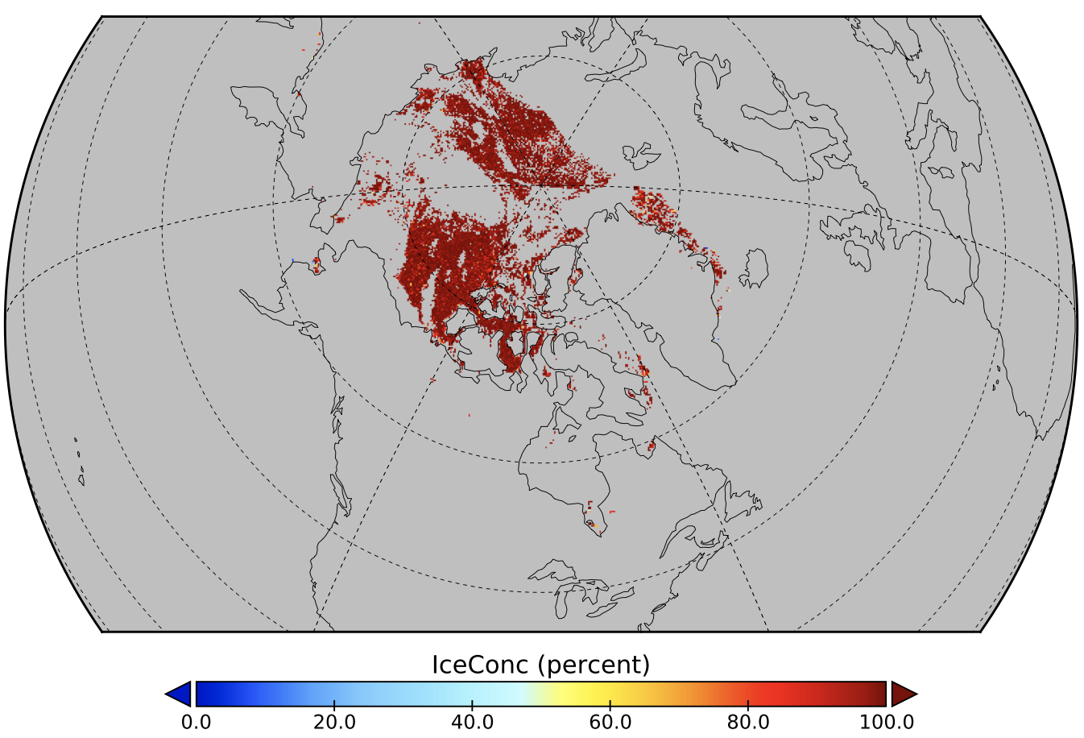
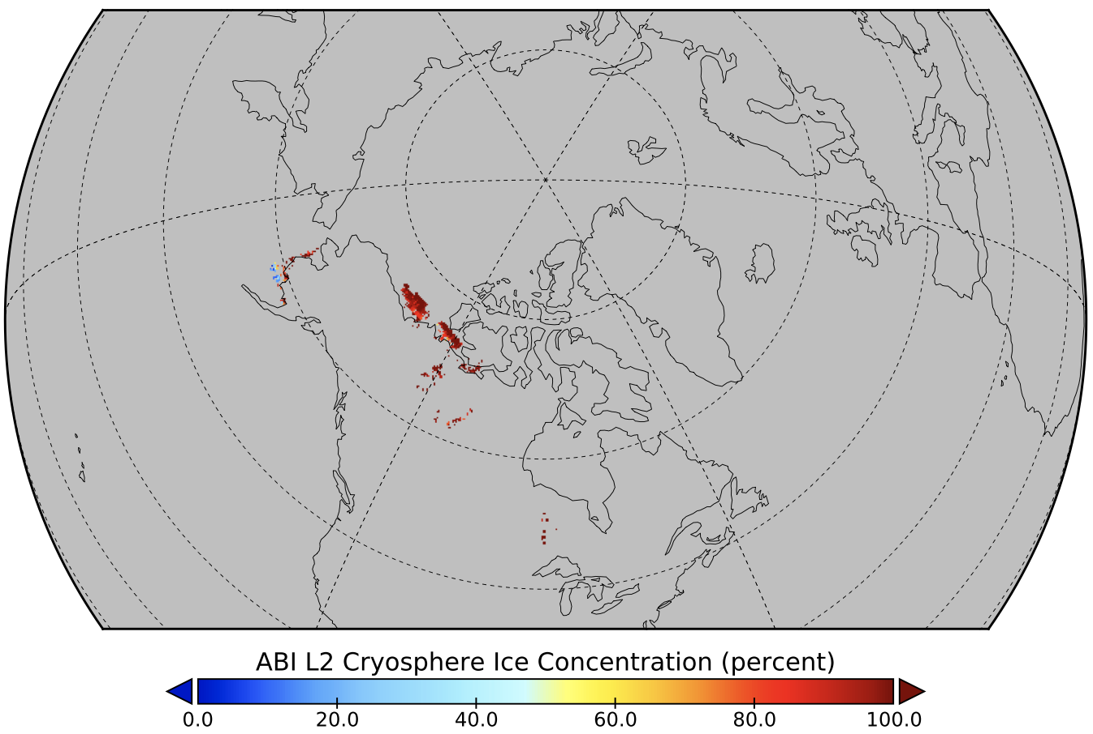
Sea and Lake Ice Concentration Validation Case Study: VIIRS vs GOES-18 ABI
VIIRS, 2022-12-12
GOES-18, 2022-12-12, 12 UTC
Ice Concentration

Slide 29
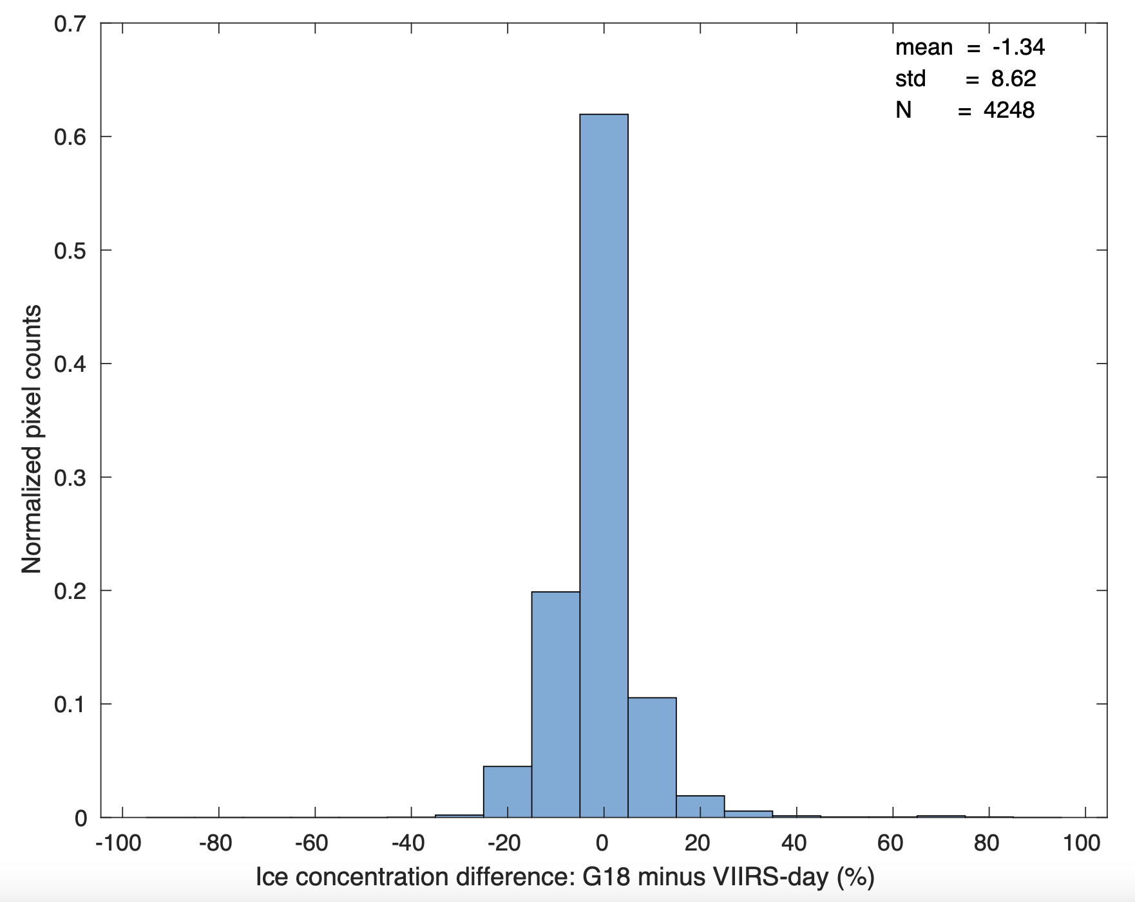
Sea and Lake Ice Concentration Validation Case Study: VIIRS vs GOES-18 ABI
GOES-18 minus VIIRS, 2022-12-12, 12 UTC
accuracy:
Ice Concentration
precision:
Accuracy: 1.34%
Precision: 8.62%

Slide 30
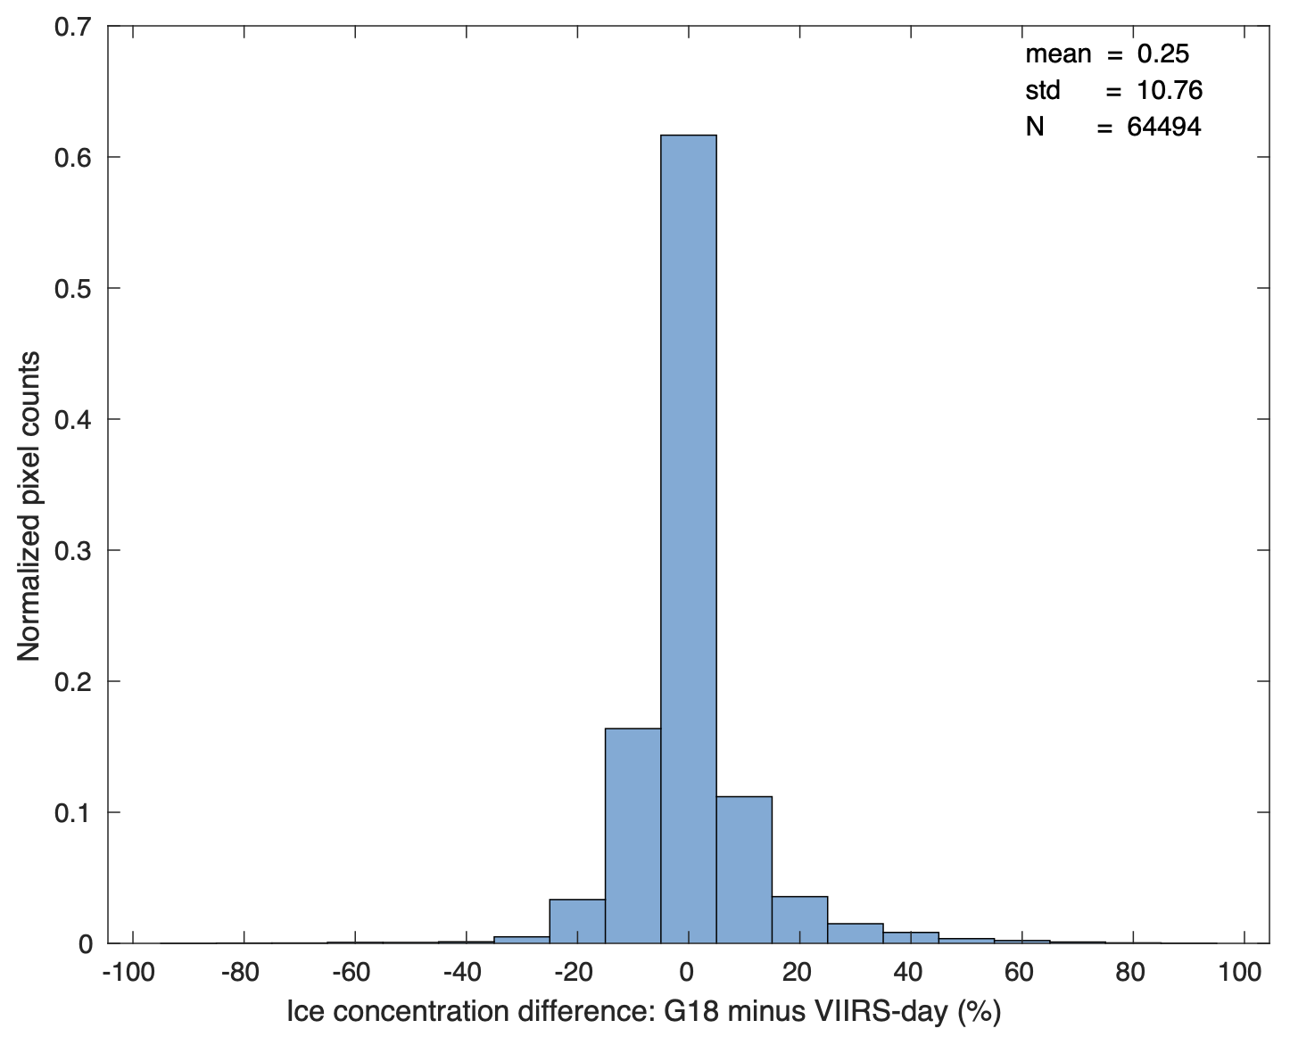
Sea and Lake Ice Concentration Validation Overall Performance: VIIRS vs GOES-18 ABI
GOES-18 minus VIIRS,
All co-located data, Nov 15 - Dec 19, 2022
Accuracy: 0.25%
Precision: 10.76%

Slide 31
Provisional Validation
End State | Assessment
Product performance has been demonstrated through analysis of independent measurements obtained from select locations, periods, and associated ground truth or field campaign efforts. | A limited, but not small, set of product examples have been evaluated.
Product analysis is sufficient to communicate product performance to users relative to expectations (Performance Baseline). | True
Documentation of product performance exists that includes recommended remediation strategies for all anomalies and weaknesses. Any algorithm changes associated with severe anomalies have been documented, implemented, tested, and shared with the user community. | There are no anomalies or significant weaknesses.
Testing has been fully documented. | This slide set is the documentation for test results.
Product is ready for operational use and for use in comprehensive cal/val activities and product optimization. | True

Slide 32
Path to Full Maturity
We expect to carry out the same activities for future maturity review
The collection of Ground System ice products will continue.
Case studies will be carried out.
Validation employing data from polar-orbiting satellites and aircraft data will continue.
Validation using high spatial resolution sensor data like Landsat will be performed.
Install, test, and review the Enterprise algorithm.

Slide 33
Validation Summary
GOES-18 ABI ice concentration and ice cover products are evaluated using GOES-16, VIIRS, AMSR2 ice concentration products.
Results show the ABI ice concentration has a measurement accuracy of 1.27%, 2.28%, 0.25% and precision of 7.86%, 11.05%, 10.76% for GOES-18 with a 2 km remapped comparison with GOES-16, AMSR2, VIIRS, respectively, which meets the requirement of accuracy at 10% and precision at 30%.
A previous study showed that remapping the products to a 4 km EASE-Grid 2.0 produced essentially the same results. Therefore, validation results are not dependent on the spatial resolution of the remapping to a common grid.

Slide 34
Summary & Recommendations
GOES-18 ABI Ice Concentration Provisional PS-PVR

Slide 35
Summary
The analysis is based on the data from November 15 – December 20, 2022.
Overall, the ice concentration product meets the mission requirement of accuracy and precision.

Slide 36
Recommendation
The AWG Cryosphere Team believes that GOES-18 ice concentration product has reached Provisional Maturity.

Slide 37
GOES-18 ABI L2+
Provisional PS-PVR
Ice Age/Thickness
Presenter : Xuanji Wang
CIMSS/UW-Madison
December 29, 2022
GOES-R AWG
Notes:
PS-PVR - Peer-Stakeholder Product Validation Review

Slide 38
PRODUCT OVERVIEW & Algorithm
GOES-18 ABI Ice Age/Thickness Provisional PS-PVR

Slide 39
Ice Age/thickness Products Background
Ice age is the time period of ice existence. The mission requirement is for ice age categories, not age per se. The three categories are ice free, first year ice, and older ice.
The algorithm determines the age category based on ice thickness, which it estimates.
Ice thickness is retrieved by the One-dimensional Thermodynamic Ice Model (OTIM), based on ice surface energy budget theory.
GOES-16/18 ice age/thickness EDR is a Full Disk (FD) product.
Users needs:
One of the Essential Climate Variables (ECVs) in the Third version of the ECV Inventory by the Global Climate Observing System (GCOS) of the WMO
Alaska Ice Program’s request to monitor ice conditions
General users for long-term global ice monitoring, hydrological monitoring, numerical model prediction, ecosystem monitoring, and climate studies, etc.

Slide 40
Mission Requirements
GOES-16/18 Sea/Lake Ice Age/Thickness Mission Requirements
Satellite Source | GOES-16/18 ABI
Accuracy | 80% correct classification
Measurement Range | 0 - 3.0 m for Ice Thickness Ice free, first year, and older ice classification for Ice Age
Latency | 3236 seconds
Timeliness | 3236 seconds
Refresh | 3 hours
Coverage | FD
Horizontal Resolution | FD – 2 km
Cloud Cover Conditions Qualifier | Clear Conditions associated with threshold accuracy
Temporal Qualifier | Ice Covered waters; Day and Night Day with sun at less than 67 degree solar zenith angle
Product Extent Qualifier | Quantitative out to at least 67 degrees LZA and qualitative at larger LZA (Note: AITA is processed out to LZA = 80 degrees)

Slide 41
Ice Age/Thickness Processing Flow
Top-Level Processing:
OTIM and Ice age classification begin
ABI Channel Used: Retrieved products, e.g., cloud, IST.
Algorithm Dependencies: See separate slide.
Ancillary Data Dependencies: NWP/NCEP/ECMWF, et al.
Products Generated: Ice thickness and age and associated quality flags.
Surface air temperature, pressure, wind, and moisture (optional)
Cloud mask, ice physical properties, snow cover, sea/lake mask
Ice type
end
For each pixel
Surface albedo
Surface temperature
Surface radiative fluxes
Surface heat fluxes
One-dimensional Thermodynamic Ice Model - OTIM
All-sky sea/lake ice thickness
For each pixel
Sea/lake ice age classification
end
All-sky sea/lake ice age
OTIM and Ice age Classification end

Slide 42
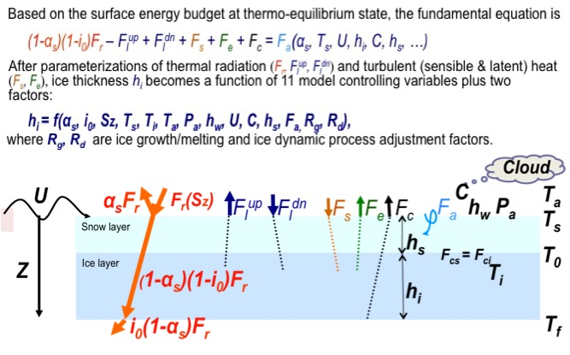
Ice Age/Thickness Algorithm Overview
One-Dimensional Thermodynamic Ice Model (OTIM)
One-dimensional Thermodynamic Ice Model (OTIM)

Slide 43
GOES-16/18 Ice Age/Thickness Product Algorithm Dependencies
OTIM Algorithm Dependencies
Cloud products
Radiation products
Sounding products
Cloud mask
Solar radiation
Air temperature
Cloud fraction
Thermal radiation
Air moisture
Cloud opt. prop.
Surface albedo
Air pressure
Cryosphere ice thickness/age algorithm - OTIM
Snow cover
Ice identification
Surface skin temp.
Surface wind
Snow depth
Ice concentration

Slide 44
Product quality evaluation
GOES-18 ABI Ice Age/Thickness Provisional PS-PVR

Slide 45
Top Level Summary of Product Quality
The analysis was based on the available GOES-16/18 data from the GS/PDA for some days in December 2022.
The GOES-16/18 hourly data were used to make a daily composite ice products for the best chance to have maximum ice cover available and compare to other daily/weekly ice products from US NIC, NOAA-20, IceBridge. Some are indirect comparisons.
Since ice age is based on ice thickness, we want to go beyond about the validation by checking the ice thickness accuracy in comparison with the data from other sources as well.
Overall, the GOES-18 ice age/thickness products meet the requirements.

Slide 46
PLPTs three stages validation
There are currently no Full Validation PLPTs for ice products. The table below lists the types of tests to be performed.
TEST ID | Short Description
ABI-FD_Ice01 (Beta) | Verify each product is generated at the required cadence for FD
ABI-FD_Ice02 (Provisional) | Perform qualitative inspection of each FD product
ABI-FD_Ice03 (Full) | Assess the accuracy and precision of each FD product

Slide 47
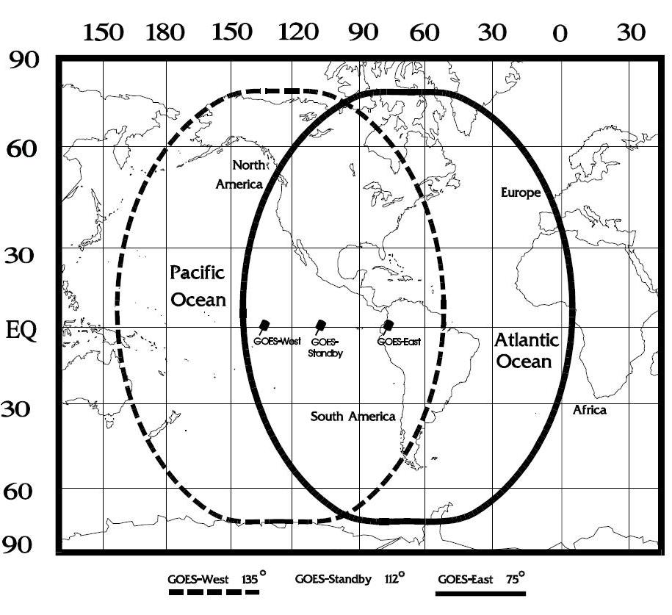
GOES-16/18 Data Used in this Review
GOES-16/18 GS/PDA Data
– December 1-25, 2022
– Hourly and daily composite FD data
– Focus on Hudson Bay and Great
Lakes where GOES-16/18 cover and
ice formed over the period
– Performance/accuracy was
examined

Slide 48
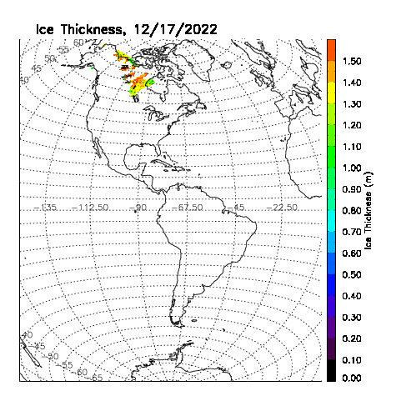
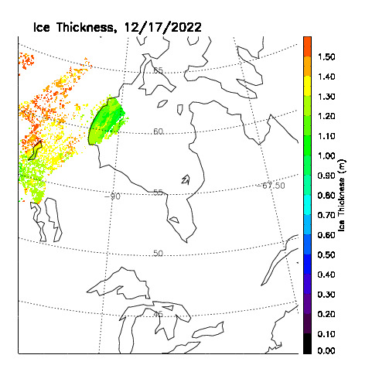
Qualitative/Visual Inspection
GOES-18, 2022-12-17, Ice Thickness
GOES-18, 2022-12-17, Ice Thickness
GOES-18 daily composite ice thickness data from the GS/PDA.

Slide 49
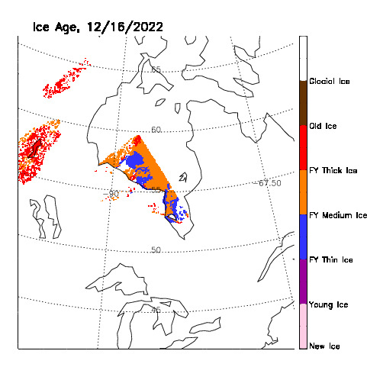
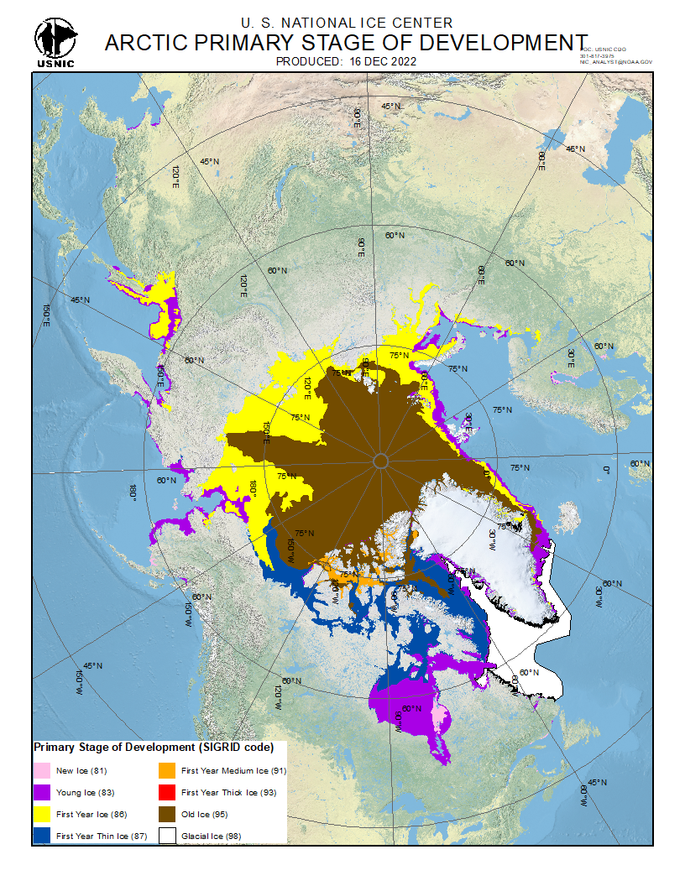
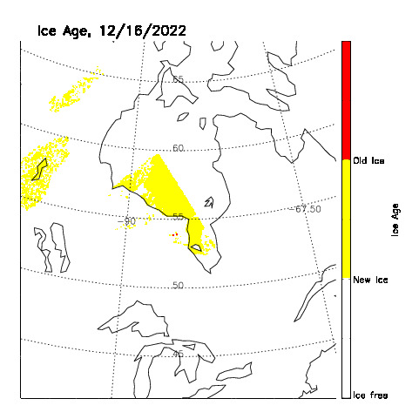
Qualitative/Visual Inspection
GOES-18, 2022-12-16, Ice Age and SOD
US NIC, 2022-12-16, Ice SOD
Ice stage of development (SOD) using ABI data in terms of NIC SOD classification scheme.
Ice age using ABI data in terms of requirements.
Ice free (<0.001 cm), new/first year ice (0.001 ~ 180 cm), old ice (>180 cm)

Slide 50
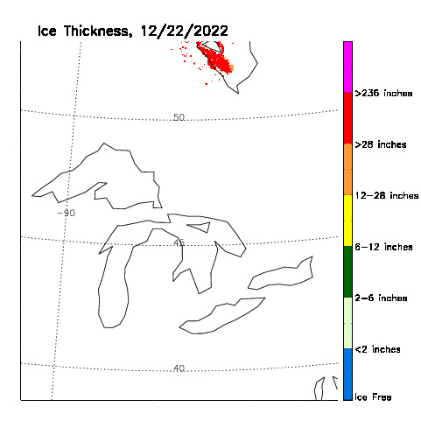
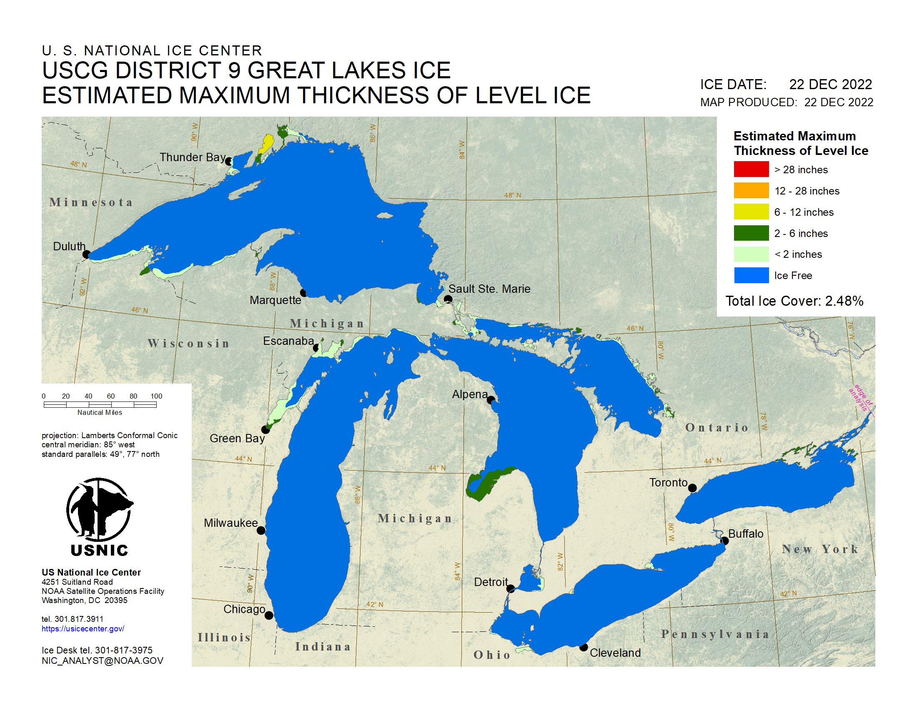
Qualitative/Visual Inspection
GOES-18, 2022-12-22, Ice Thickness
US NIC, 2021-12-22, Ice Thickness
No ice retrieved with GOES-18 data due to cloudy sky over ice area.

Slide 51
PRODUCT VALIDATION
GOES-18 ABI Ice Age/Thickness Provisional PS-PVR

Slide 52
Reference Data
NIC Ice Chart
- December 1 ~ 25, 2022
VIIRS NOAA-20 Data
- Nov 15 – Dec 19, 2022
IceBridge Ice Thickness data (Indirect validation for algorithm)
- April 6, 2019

Slide 53
Validation Procedures
There are no in-situ measurements of ice thickness in the Great Lakes or Hudson Bay during this period, which are the primary areas for ABI ice products.
Therefore, ABI ice thickness is compared to National Ice Center ice charts (qualitatively), and the thickness data from Icebridge data (quantitatively and indirectly).
Note that the requirement is for correct classification in three categories: ice free, first-year ice, and older ice. In the Great Lakes and Hudson Bay, all ice is first-year ice! Meeting that requirement is relatively easy, so we have chosen to validate many more age categories as well as ice thickness.

Slide 54
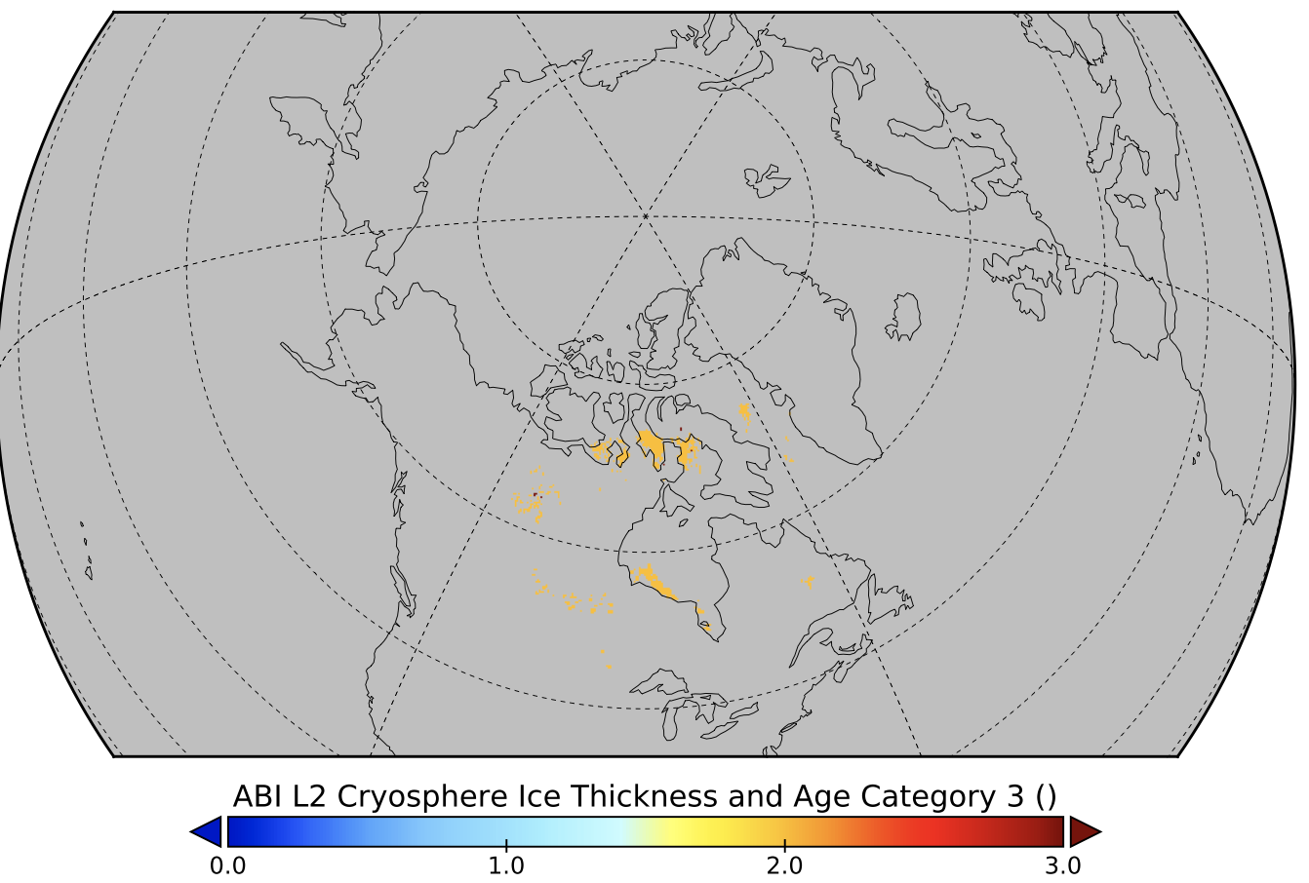
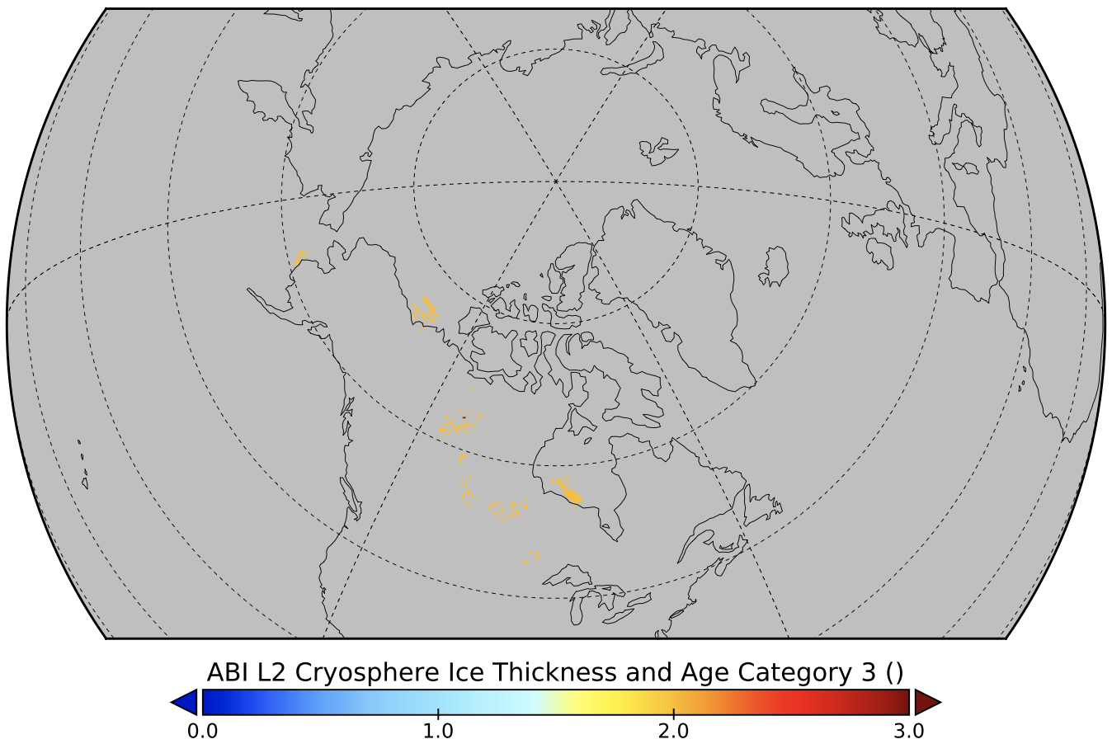
Sea and Lake Ice Age/Thickness Validation Case Study: GOES-16 vs GOES-18 ABI
GOES-16, 2022-12-20, 12 UTC
GOES-18, 2022-12-20, 12 UTC
Ice Age

Slide 55
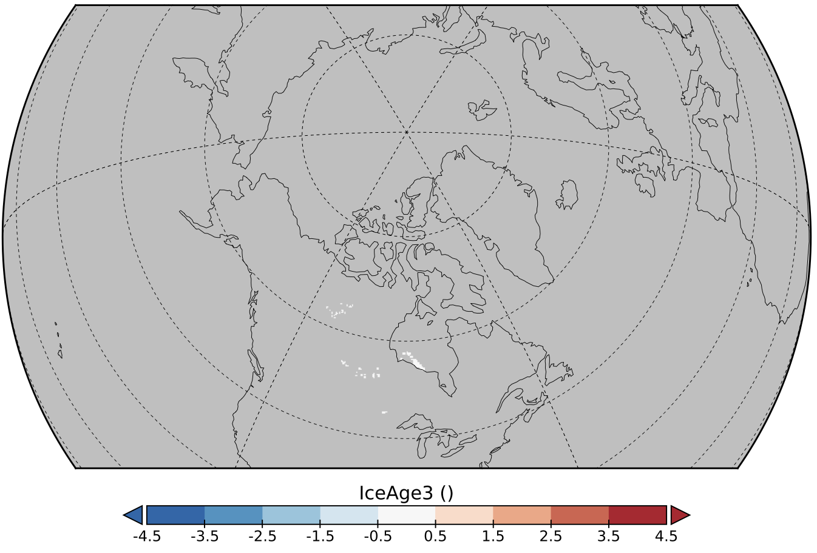
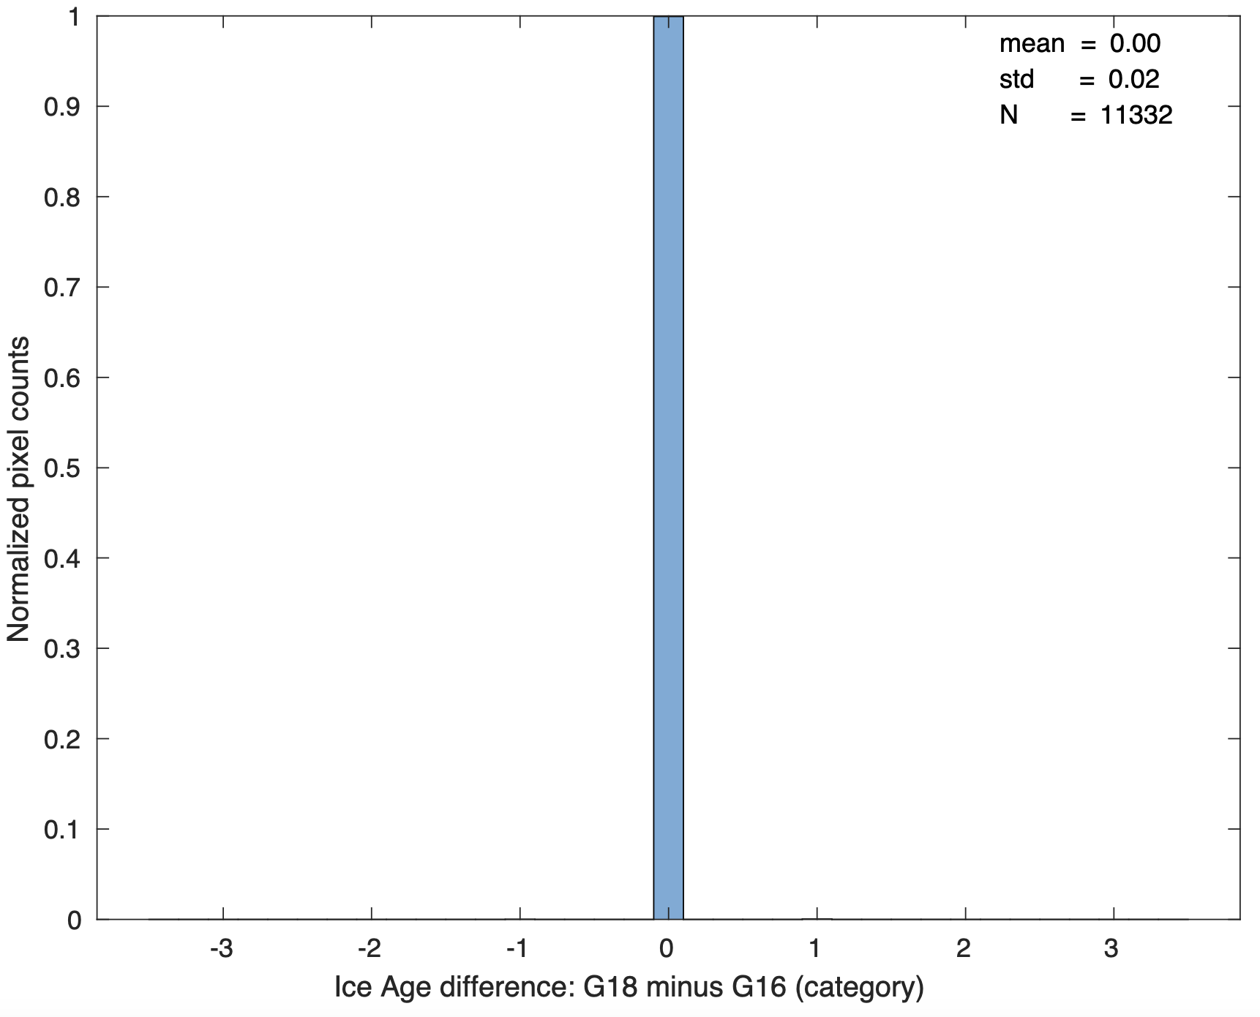
Sea and Lake Ice Age/Thickness Validation Case Study: GOES-16 vs GOES-18 ABI
GOES-18 minus GOES-16, 2022-12-20, 12 UTC
Ice Age
accuracy:
precision:
Accuracy: 0.00
Precision: 0.02

Slide 56
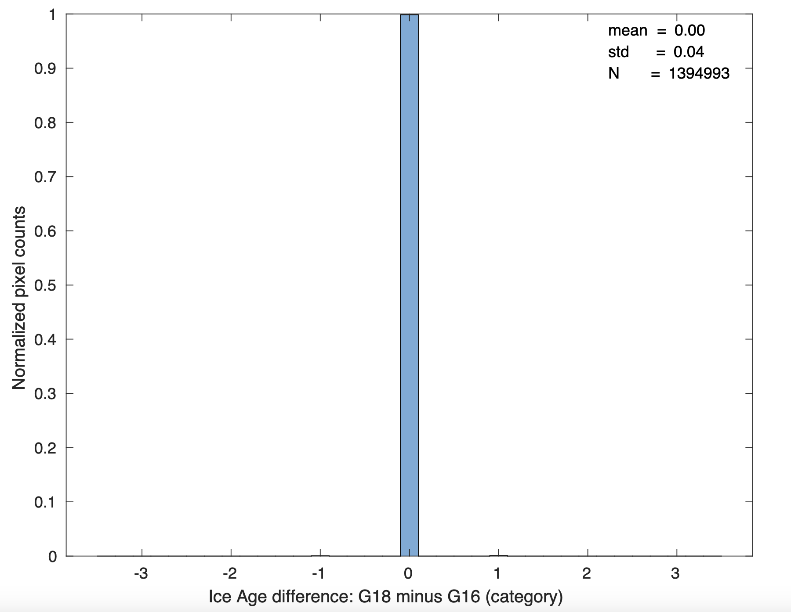
Sea and Lake Ice Age/Thickness Validation Overall Performance: GOES-16 vs GOES-18
GOES-18 minus GOES-16,
All co-located ice age data, Nov 15 - Dec 20, 2022
Accuracy: 0.00
Precision: 0.04

Slide 57
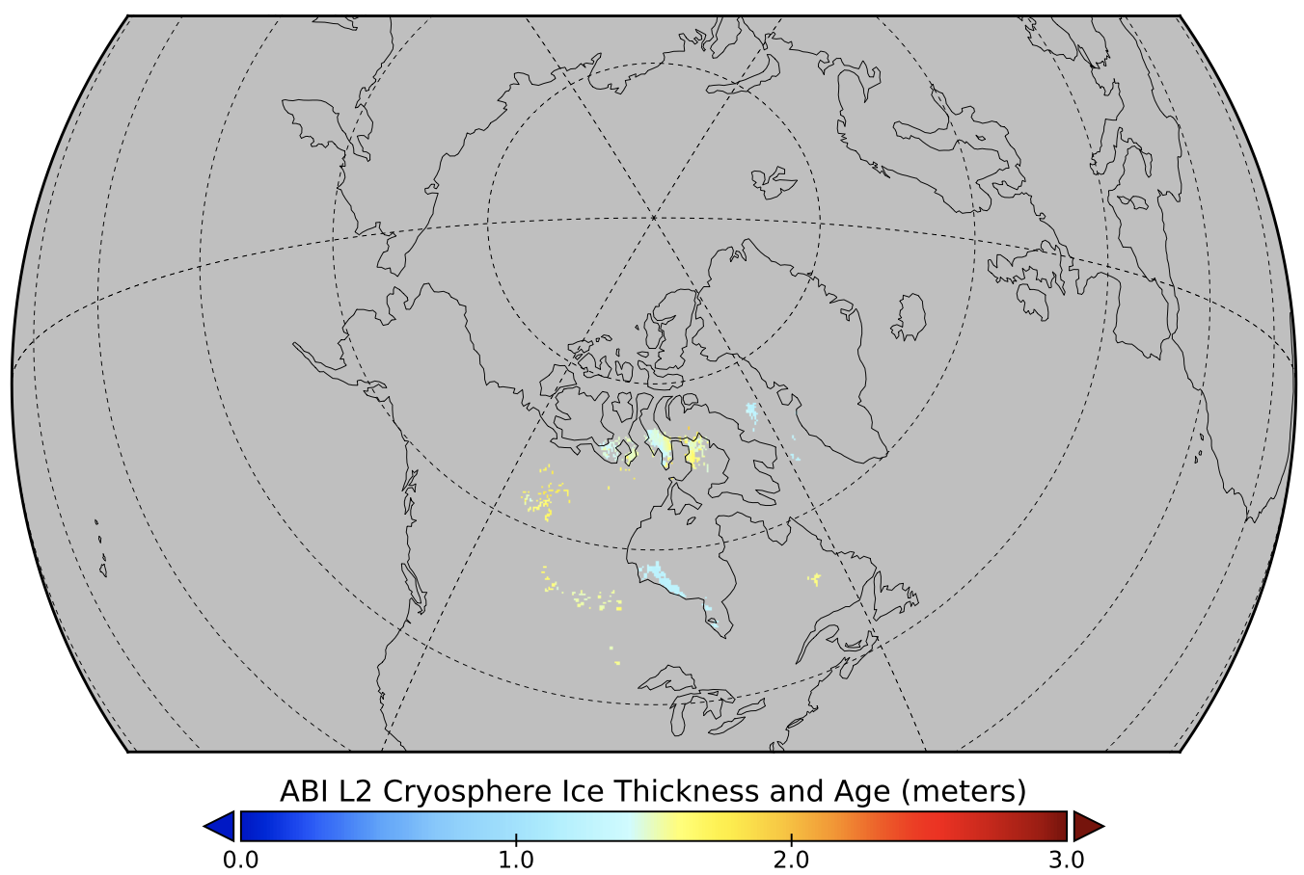
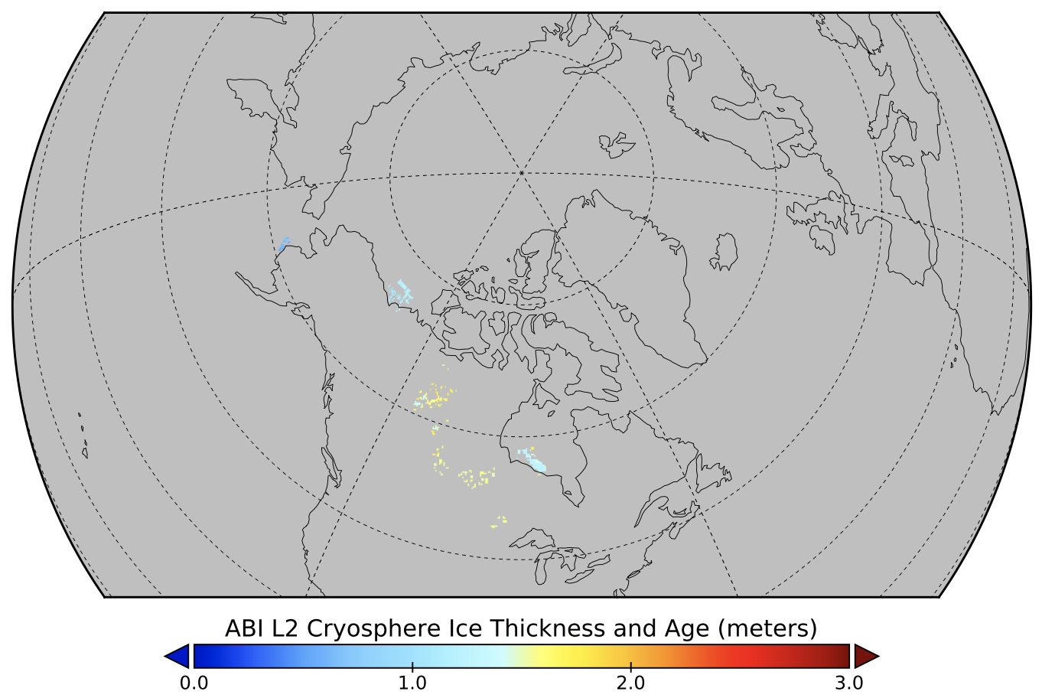
Sea and Lake Ice Age/Thickness Validation Case Study: GOES-16 vs GOES-18 ABI
GOES-16, 2022-12-20, 12 UTC
GOES-18, 2022-12-20, 12 UTC
Ice Thickness

Slide 58
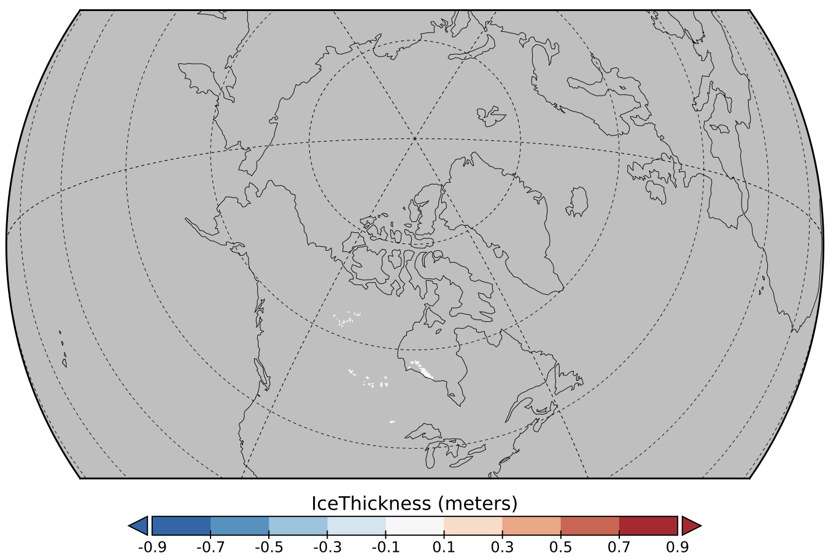
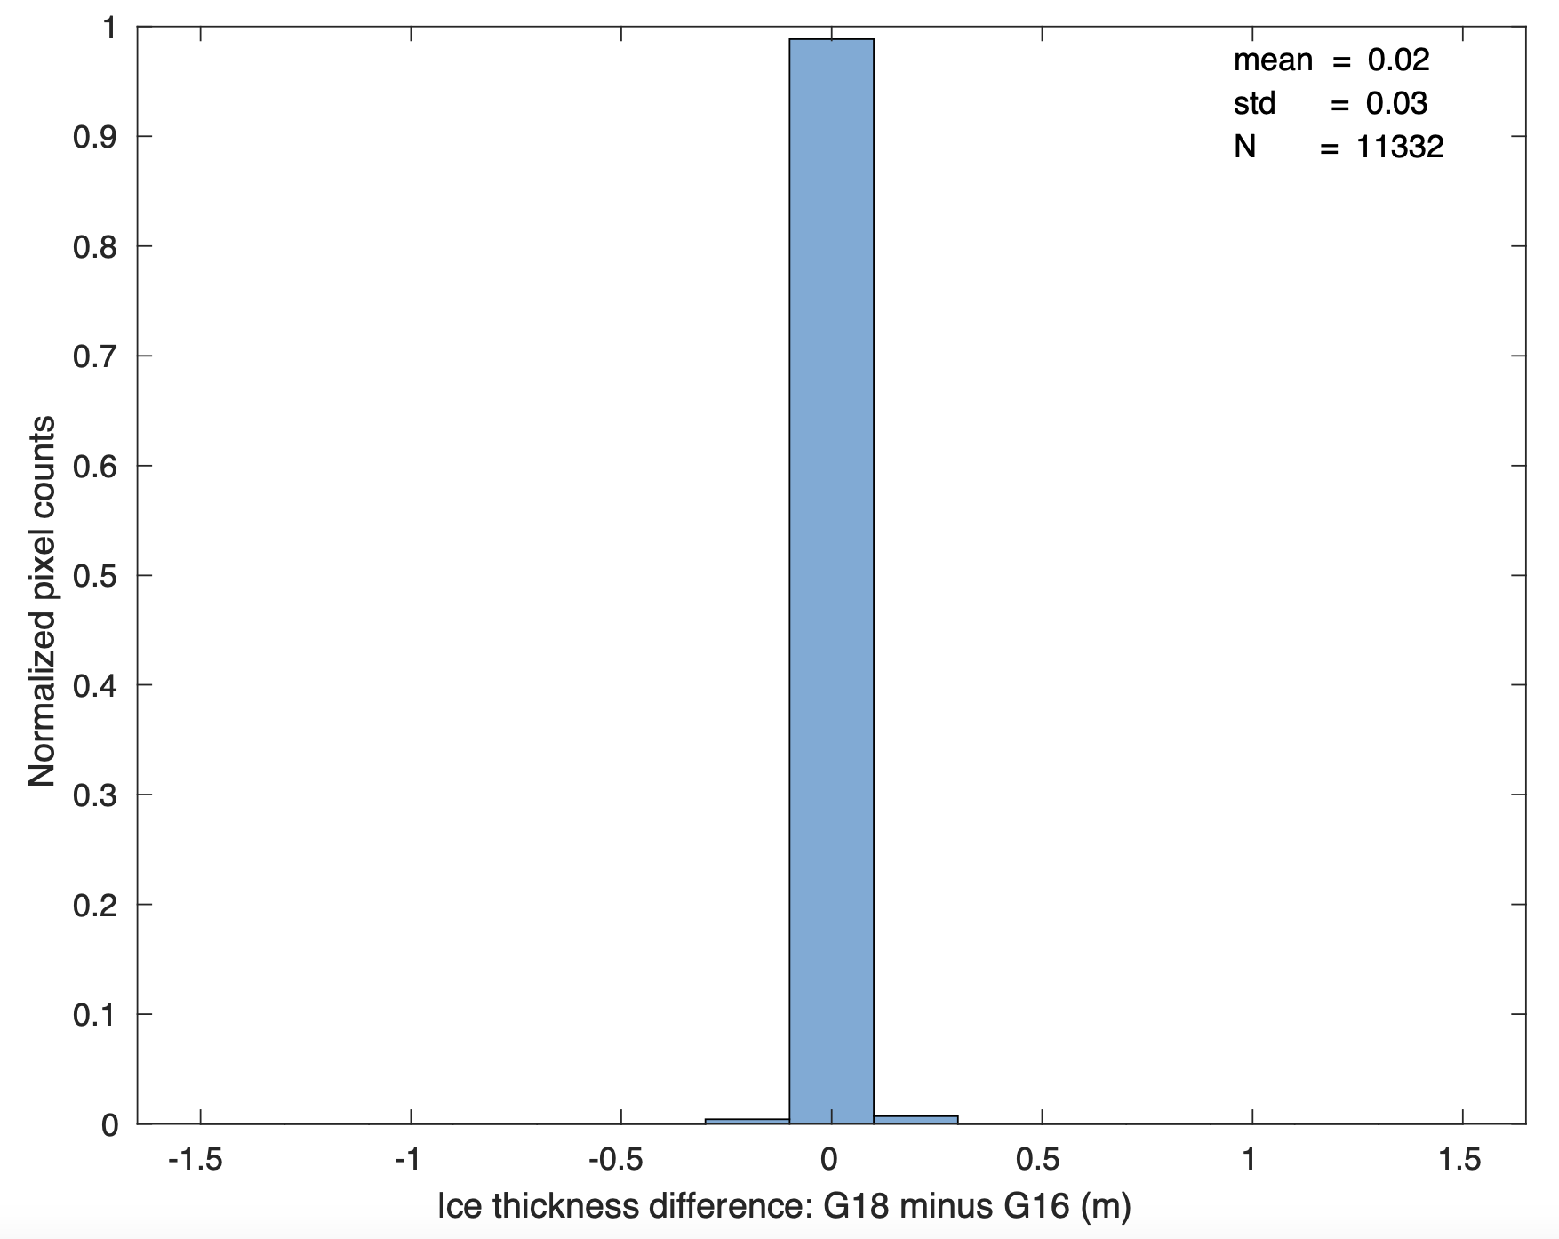
Sea and Lake Ice Age/Thickness Validation Case Study: GOES-16 vs GOES-18 ABI
GOES-18 minus GOES-16, 2022-12-20, 12 UTC
accuracy:
Ice Thickness
precision:
Accuracy: 0.02 m
Precision: 0.03 m

Slide 59
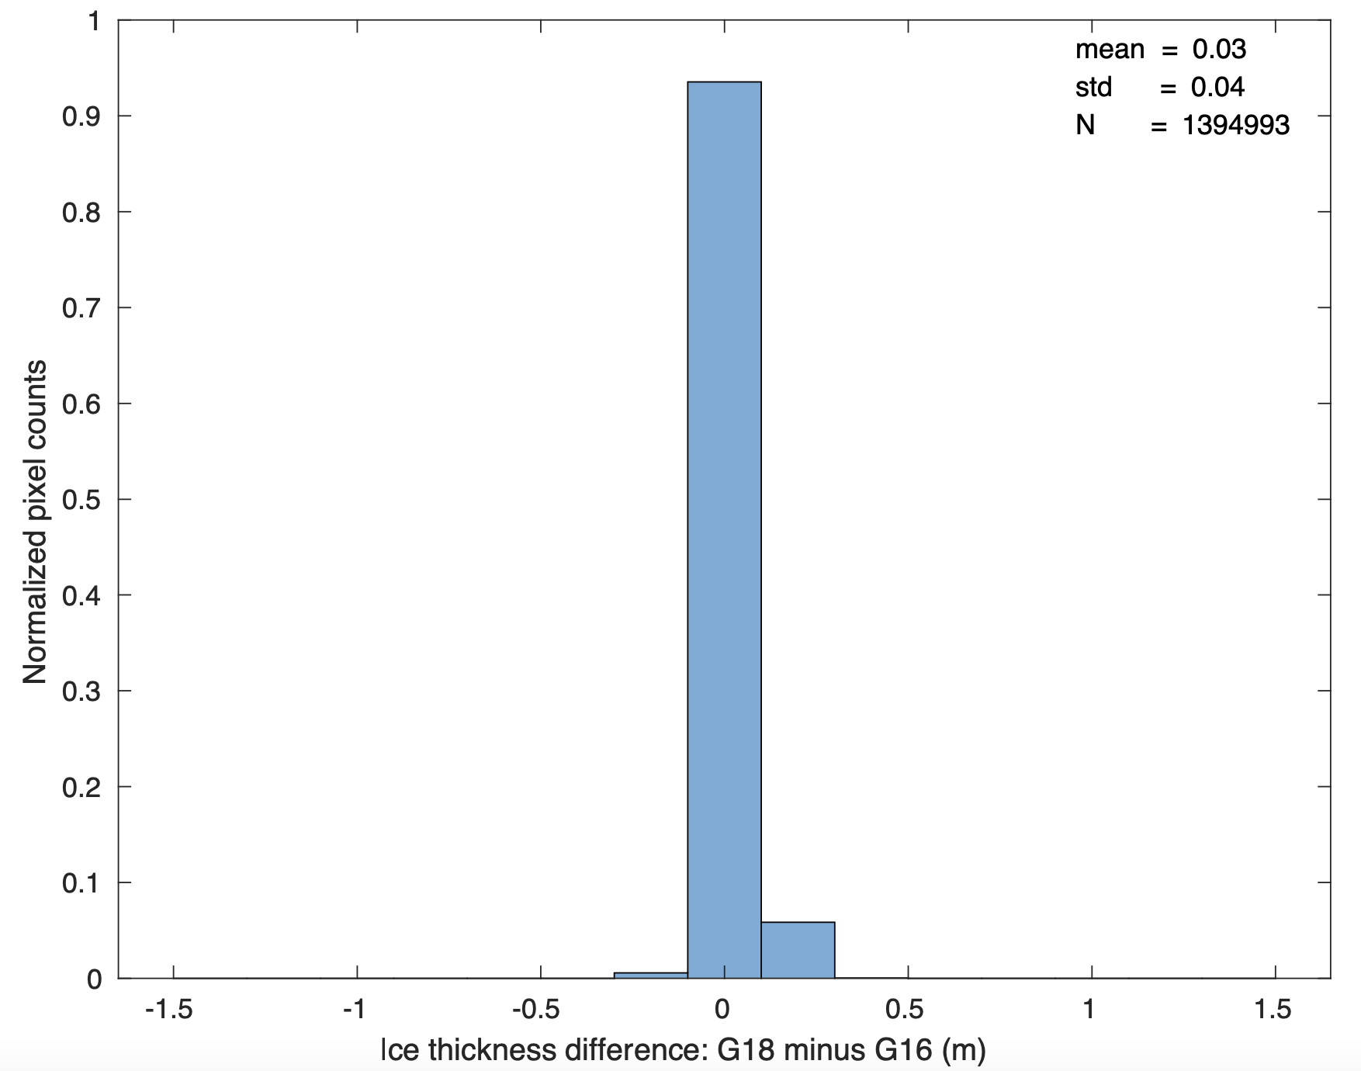
Sea and Lake Ice Age/Thickness Validation Overall Performance: GOES-16 vs GOES-18
GOES-18 minus GOES-16,
All co-located ice thickness data, Nov 15 - Dec 20, 2022
Accuracy: 0.03 m
Precision: 0.04 m

Slide 60
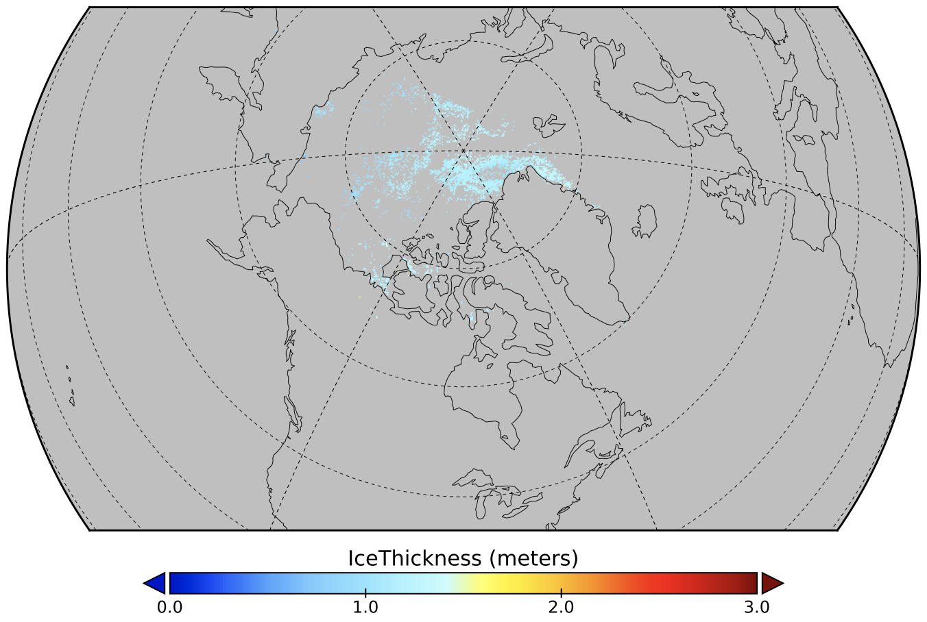
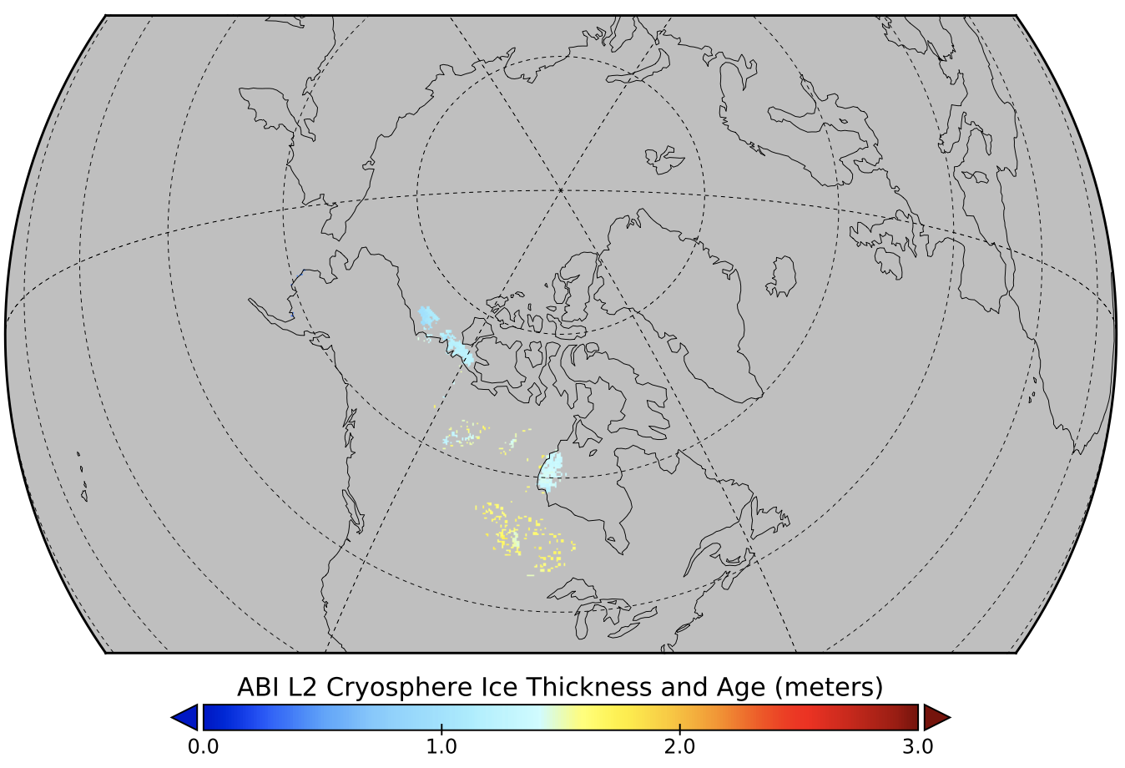
Sea and Lake Ice Age/Thickness Validation Case Study: GOES-18 ABI vs VIIRS
VIIRS, 2022-12-07, 12 UTC
GOES-18, 2022-12-07, 12 UTC
Ice Thickness

Slide 61
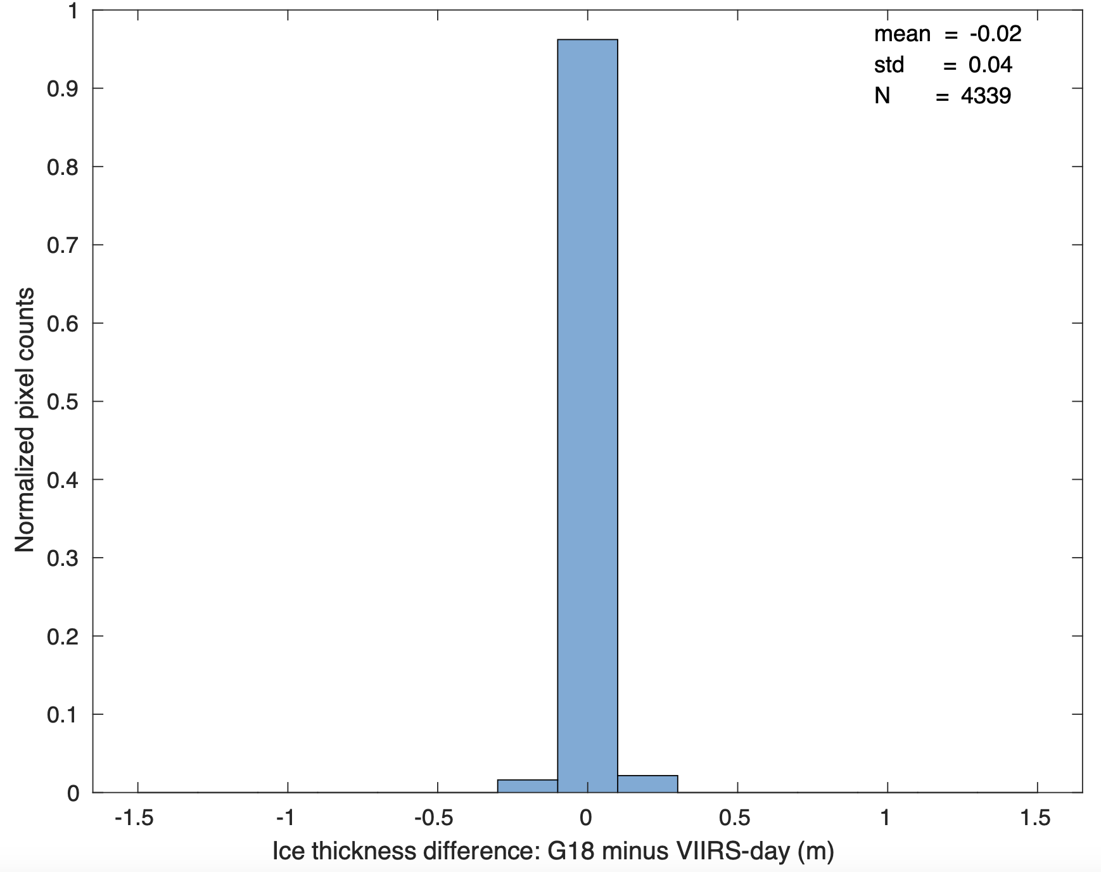
Sea and Lake Ice Age/Thickness Validation Case Study: GOES-18 ABI vs VIIRS
GOES-18 minus VIIRS, 2022-12-07, 12 UTC
accuracy:
Ice Thickness
precision:
Accuracy: 0.02 m
Precision: 0.04 m

Slide 62
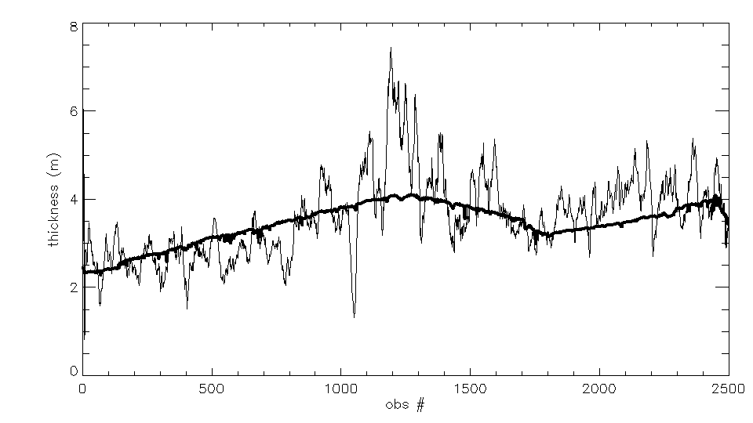
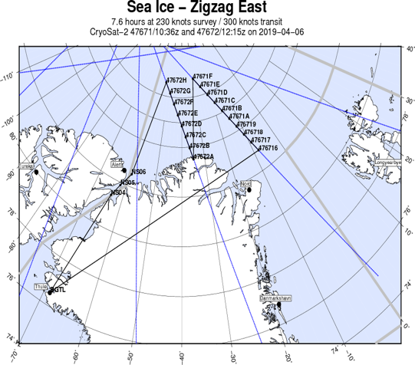
Additional Algorithm Verification: VIIRS vs IceBridge
Figure 2. NOAA-20 ice thickness product (dark, smoother line) vs. IceBridge ice thickness measurements (jumpy line) along the flight track, for approximately 2500 observations. IceBridge observations were smoothed with a running 20-point filter. The same algorithm is used for both GOES , NOAA-20 and NPP ice thickness products. From Mark A. Tschudi.
Thickness product Mean (m) St. Dev. (m)
IceBridge 2.80 2.32
NOAA-20 2.68 1.48
Accuracy of NOAA-20 VIIRS in terms of IceBridge : 95%, for all ice
62

Slide 63
Provisional Maturity Assessment
GOES-18 Ice Age/Thickness Provisional PS-PVR

Slide 64
Provisional Validation
End State | Assessment
Product performance has been demonstrated through analysis of independent measurements obtained from data sources, periods, and associated field campaign efforts. | A limited, but not small, set of product examples have been evaluated.
Product analysis is sufficient to communicate product performance to users relative to expectations (Performance Baseline). | True
Documentation of product performance exists that includes recommended remediation strategies for all uncertainties and weaknesses. Any algorithm changes associated with severe anomalies have been documented, implemented, tested, and shared with the user community. | There are no anomalies or significant weaknesses.
Testing has been fully documented. | This slide set is the documentation for test results.
Product is ready for operational use and for use in comprehensive cal/val activities and product optimization. | True

Slide 65
Path to full validation
GOES-18 ABI Ice Age/Thickness Provisional PS-PVR

Slide 66
Path to Full Maturity
We expect to carry out the same activities for future maturity review
The collection of Ground System ice products will continue.
Case studies will be carried out.
Validation employing data from other satellites (GOES-16, VIIRS, CryoSat-2, ICESat-2), aircraft (IceBridge), and in situ measurements will continue.
Install, test, and review the Enterprise algorithms.

Slide 67
Summary & Recommendations
GOES-18 ABI Ice Age/Thickness Provisional PS-PVR

Slide 68
Summary
With regard to the mission requirements, validating ice age categories (ice free, first-year and older ice) is simply a validation of the ice mask in the Great Lakes and Hudson Bay. Ice concentration validation showed that the ice mask has an accuracy well over 80%. That conclusion was confirmed here in all tests.
Given that ice age is here defined in terms of ice thickness, we have gone beyond the basic requirement by validating ice thickness itself and additional age categories through comparisons to products from NIC ice chart, IceBridge ice thickness, VIIRS ice thickness, and more in the future.
Overall, the GOES-18 ice age/thickness product meets the requirement.
Notes:
Performance of enterprise algorithm is better than baseline.

Slide 69
Recommendation
The Cryosphere Team recommends the GOES-18 ice age/thickness product for Provisional Maturity.
Promote the recently improved ABI Enterprise ice age/thickness algorithm – OTIM V6.0 to operations.
Continue monitoring of the product performance to obtain more reliable/justified/comprehensive accuracy estimates.
The AWG Cryosphere Team believes that GOES-18 ice age/thickness product has reached Provisional Maturity.
Notes:
Performance of enterprise algorithm is better than baseline.

Slide 70
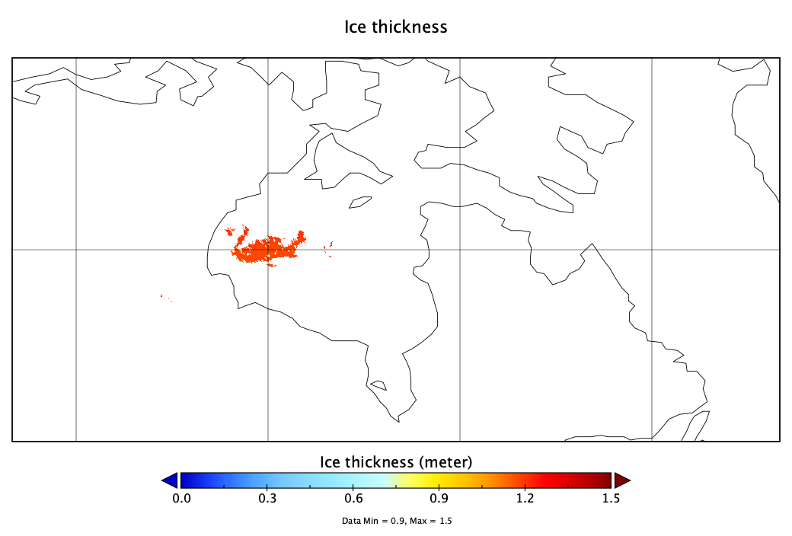
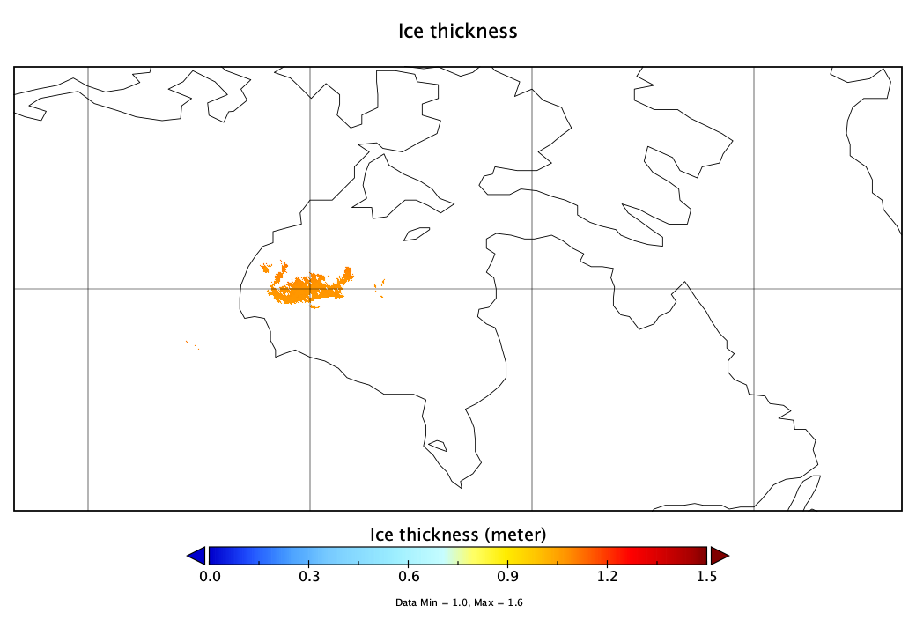
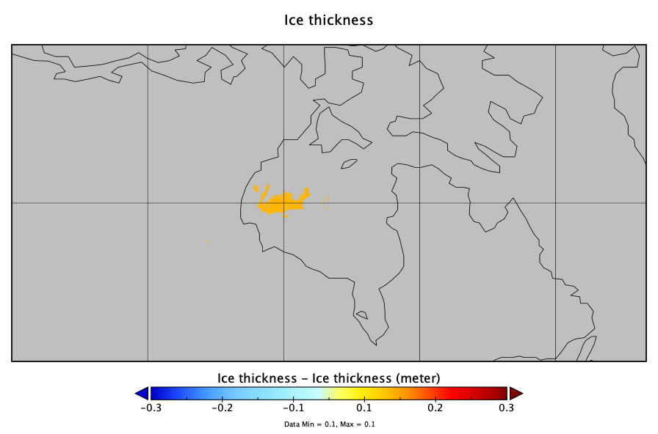
OTIM v5.0 vs OTIM v6.0
OTIM v5.0
OTIM v6.0
OTIM v5.0 minus OTIM v6.0
GOES-16 ABI ice thickness retrieved by OTIM v5.0 and OTIM v6.0, respectively for the date of December 10, 2020 at 18:40 UTC.

